Slide 1
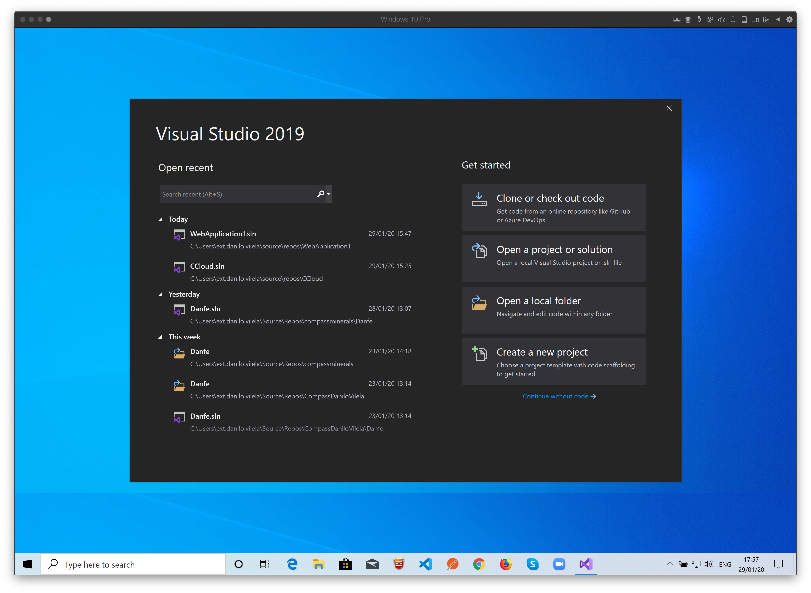

Slide 2
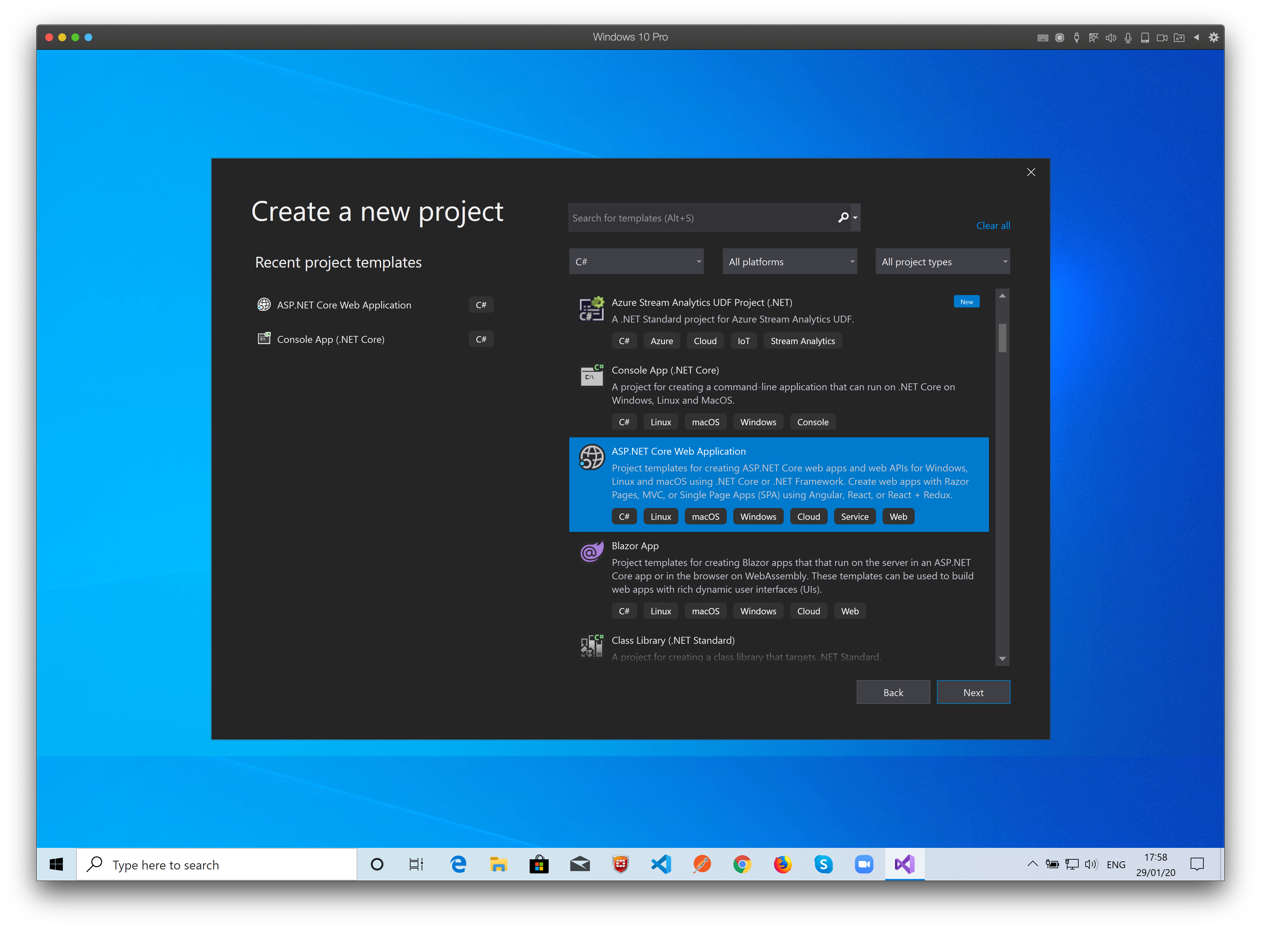
Here we select the application type.
To use web apis, Html and other web technologies we must choose “ASP.NET Core Web Application”

Slide 3
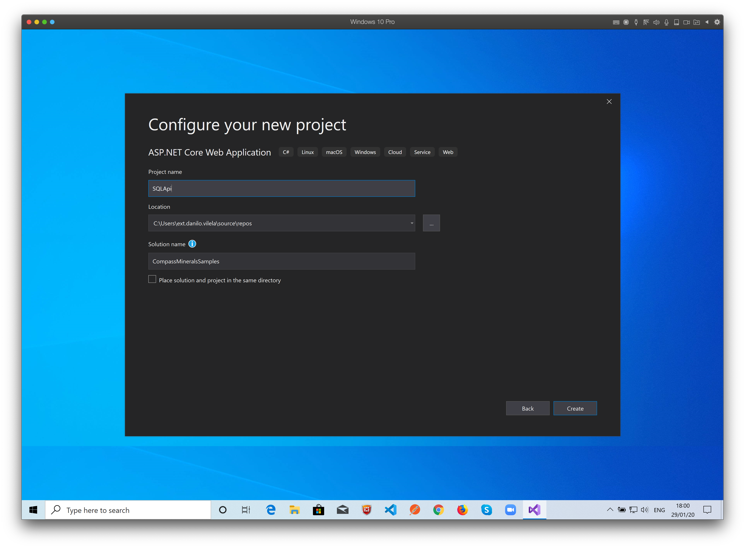
The Solution is the main container.
We can have many projects as part of one solution.
That’s why we choose different names here for the project and the solution.
All the folders and files are created based on the choices you made here.

Slide 4
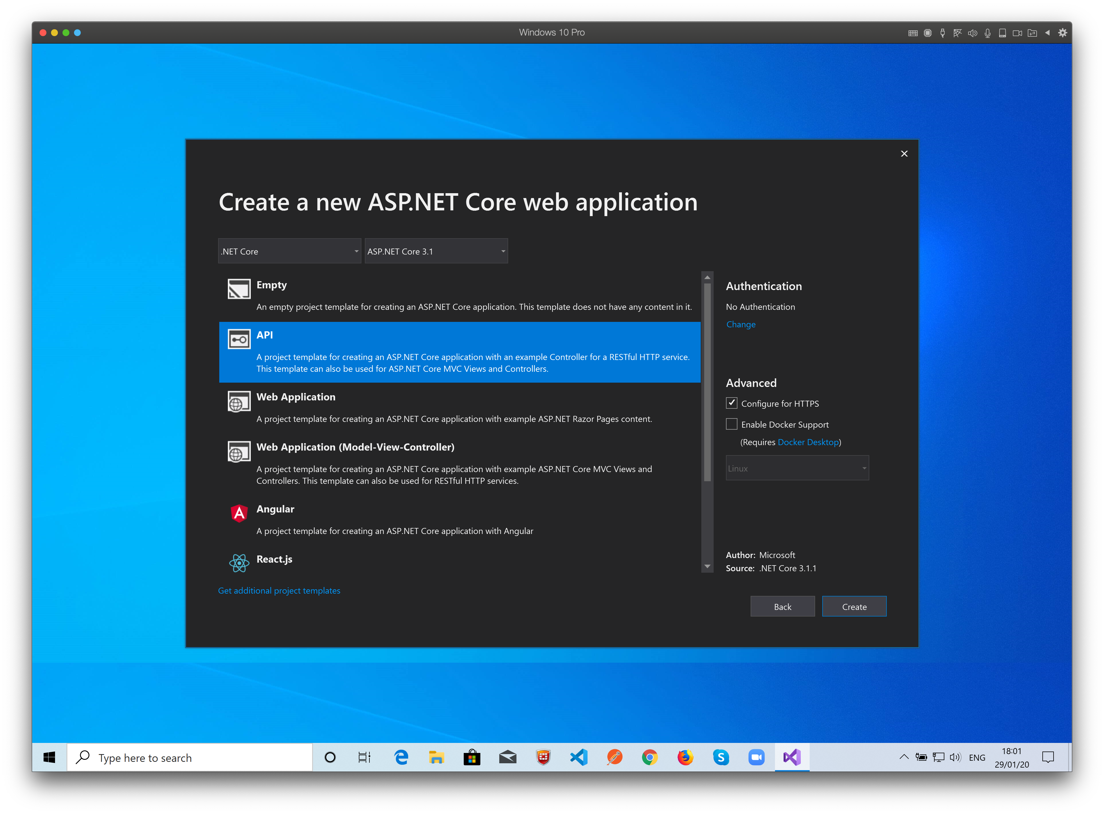
Now select the .NET Core Version and project template.
Visual Studio will create all the first project files and folders based on the template you choose.
You can add in the future any element present on the other templates!

Slide 5
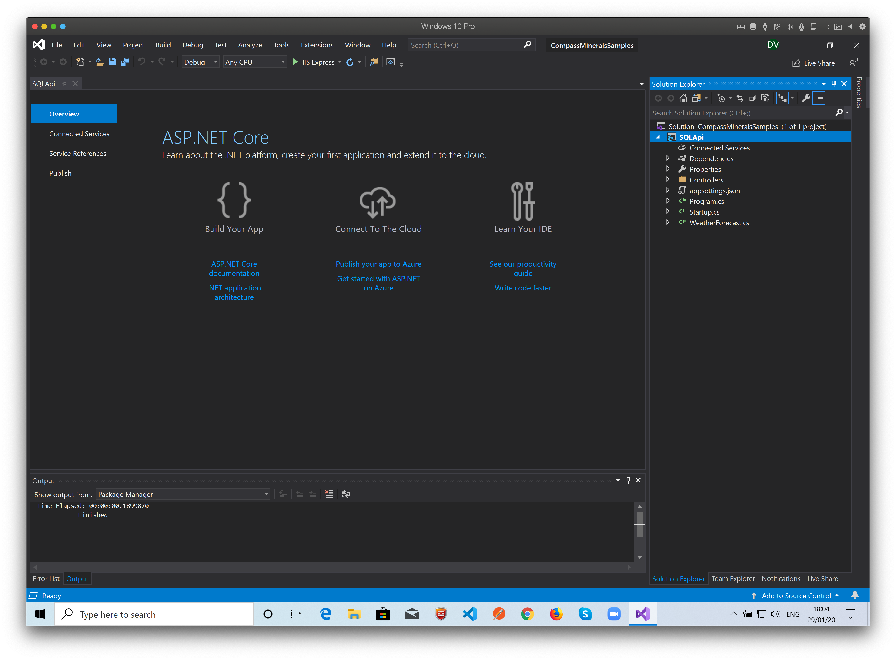
You can use the solution explorer to see and manipulate all the project items.
You can add Files, Folders, models, views and many other things.

Slide 6
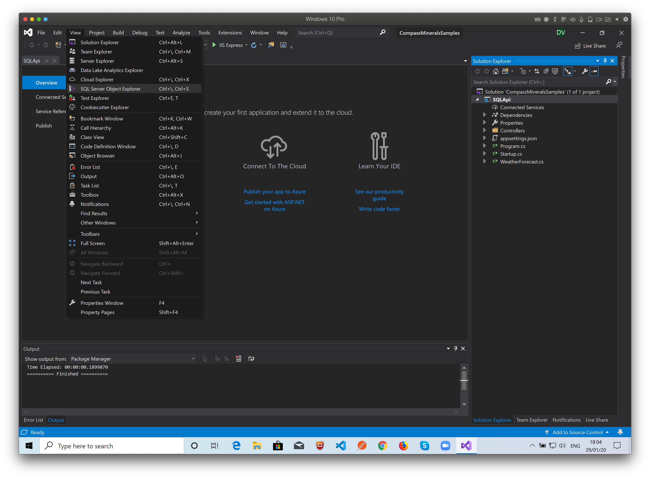
Working with databases:
From the View Menu, choose “SQL Server Object Explorer”

Slide 7
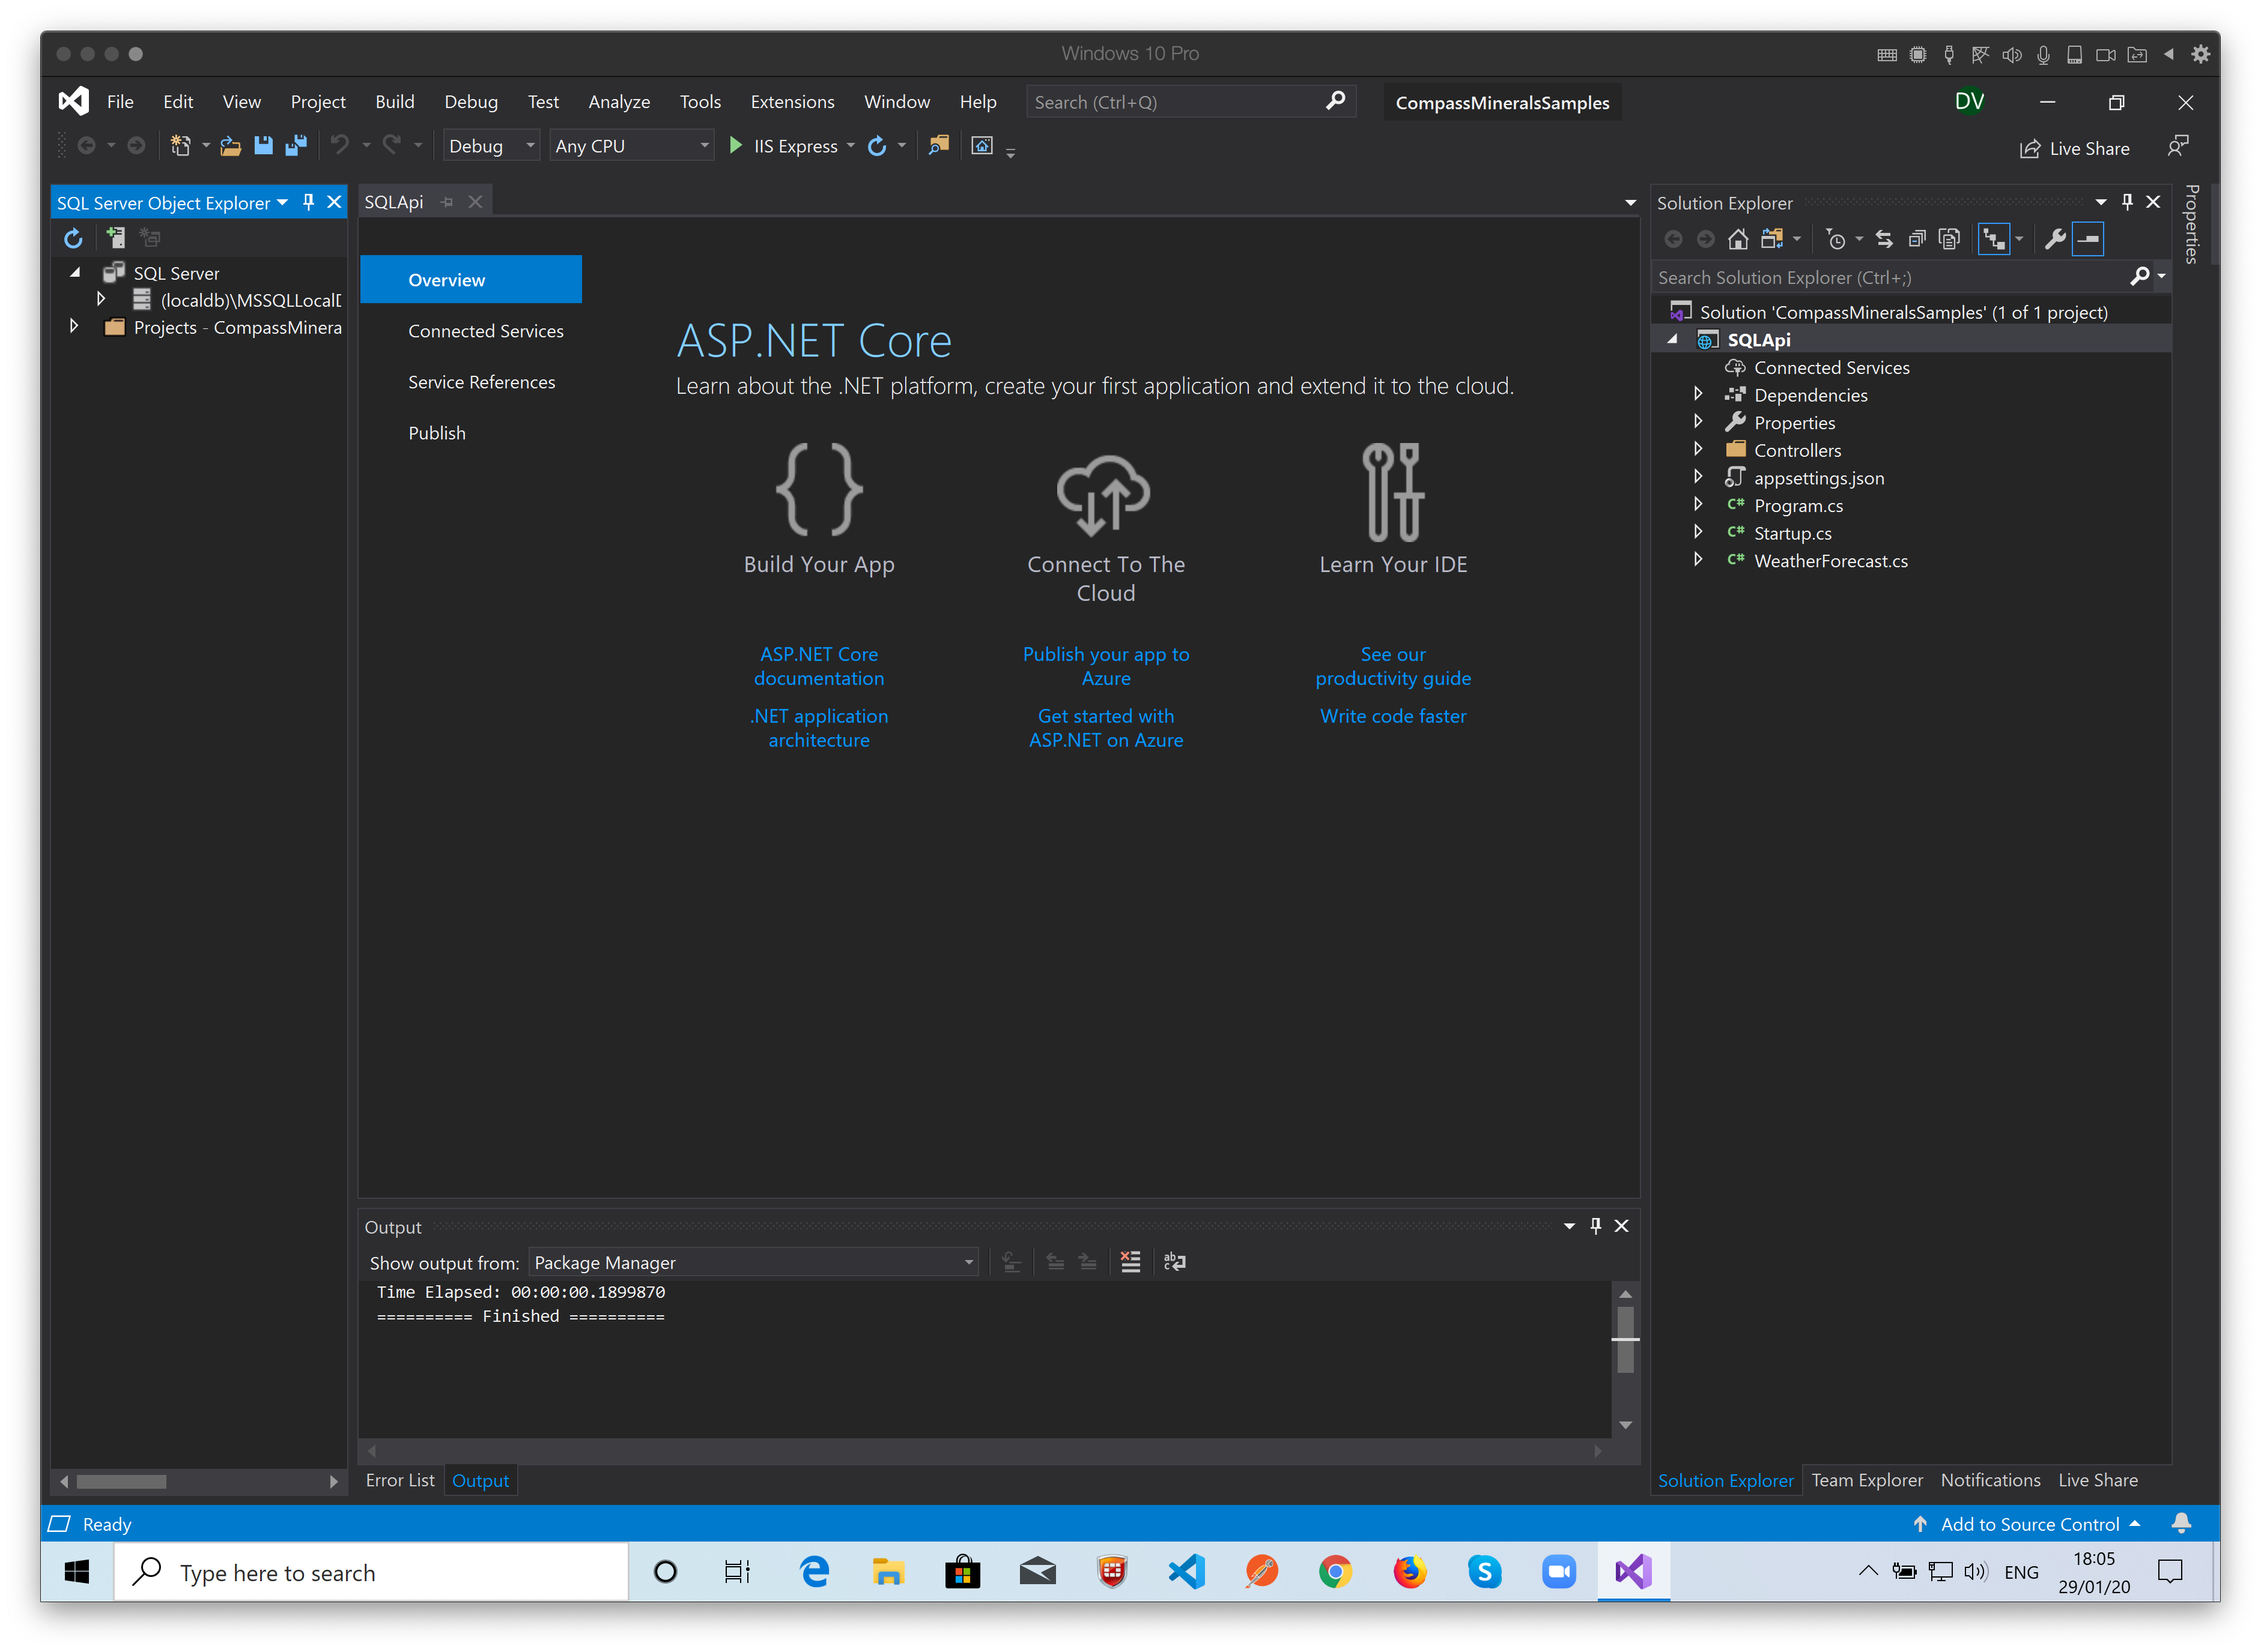
Working with databases:
On the left we have the SQL Server Object explorer.
You can connect with any SQL Server instance.
You can create Databases, Tables, Insert Data on tables…
For this example, we’ll use the SQL Server express (Installed with Visual Studio) to create a database with one table (People) and add some data to it.

Slide 8
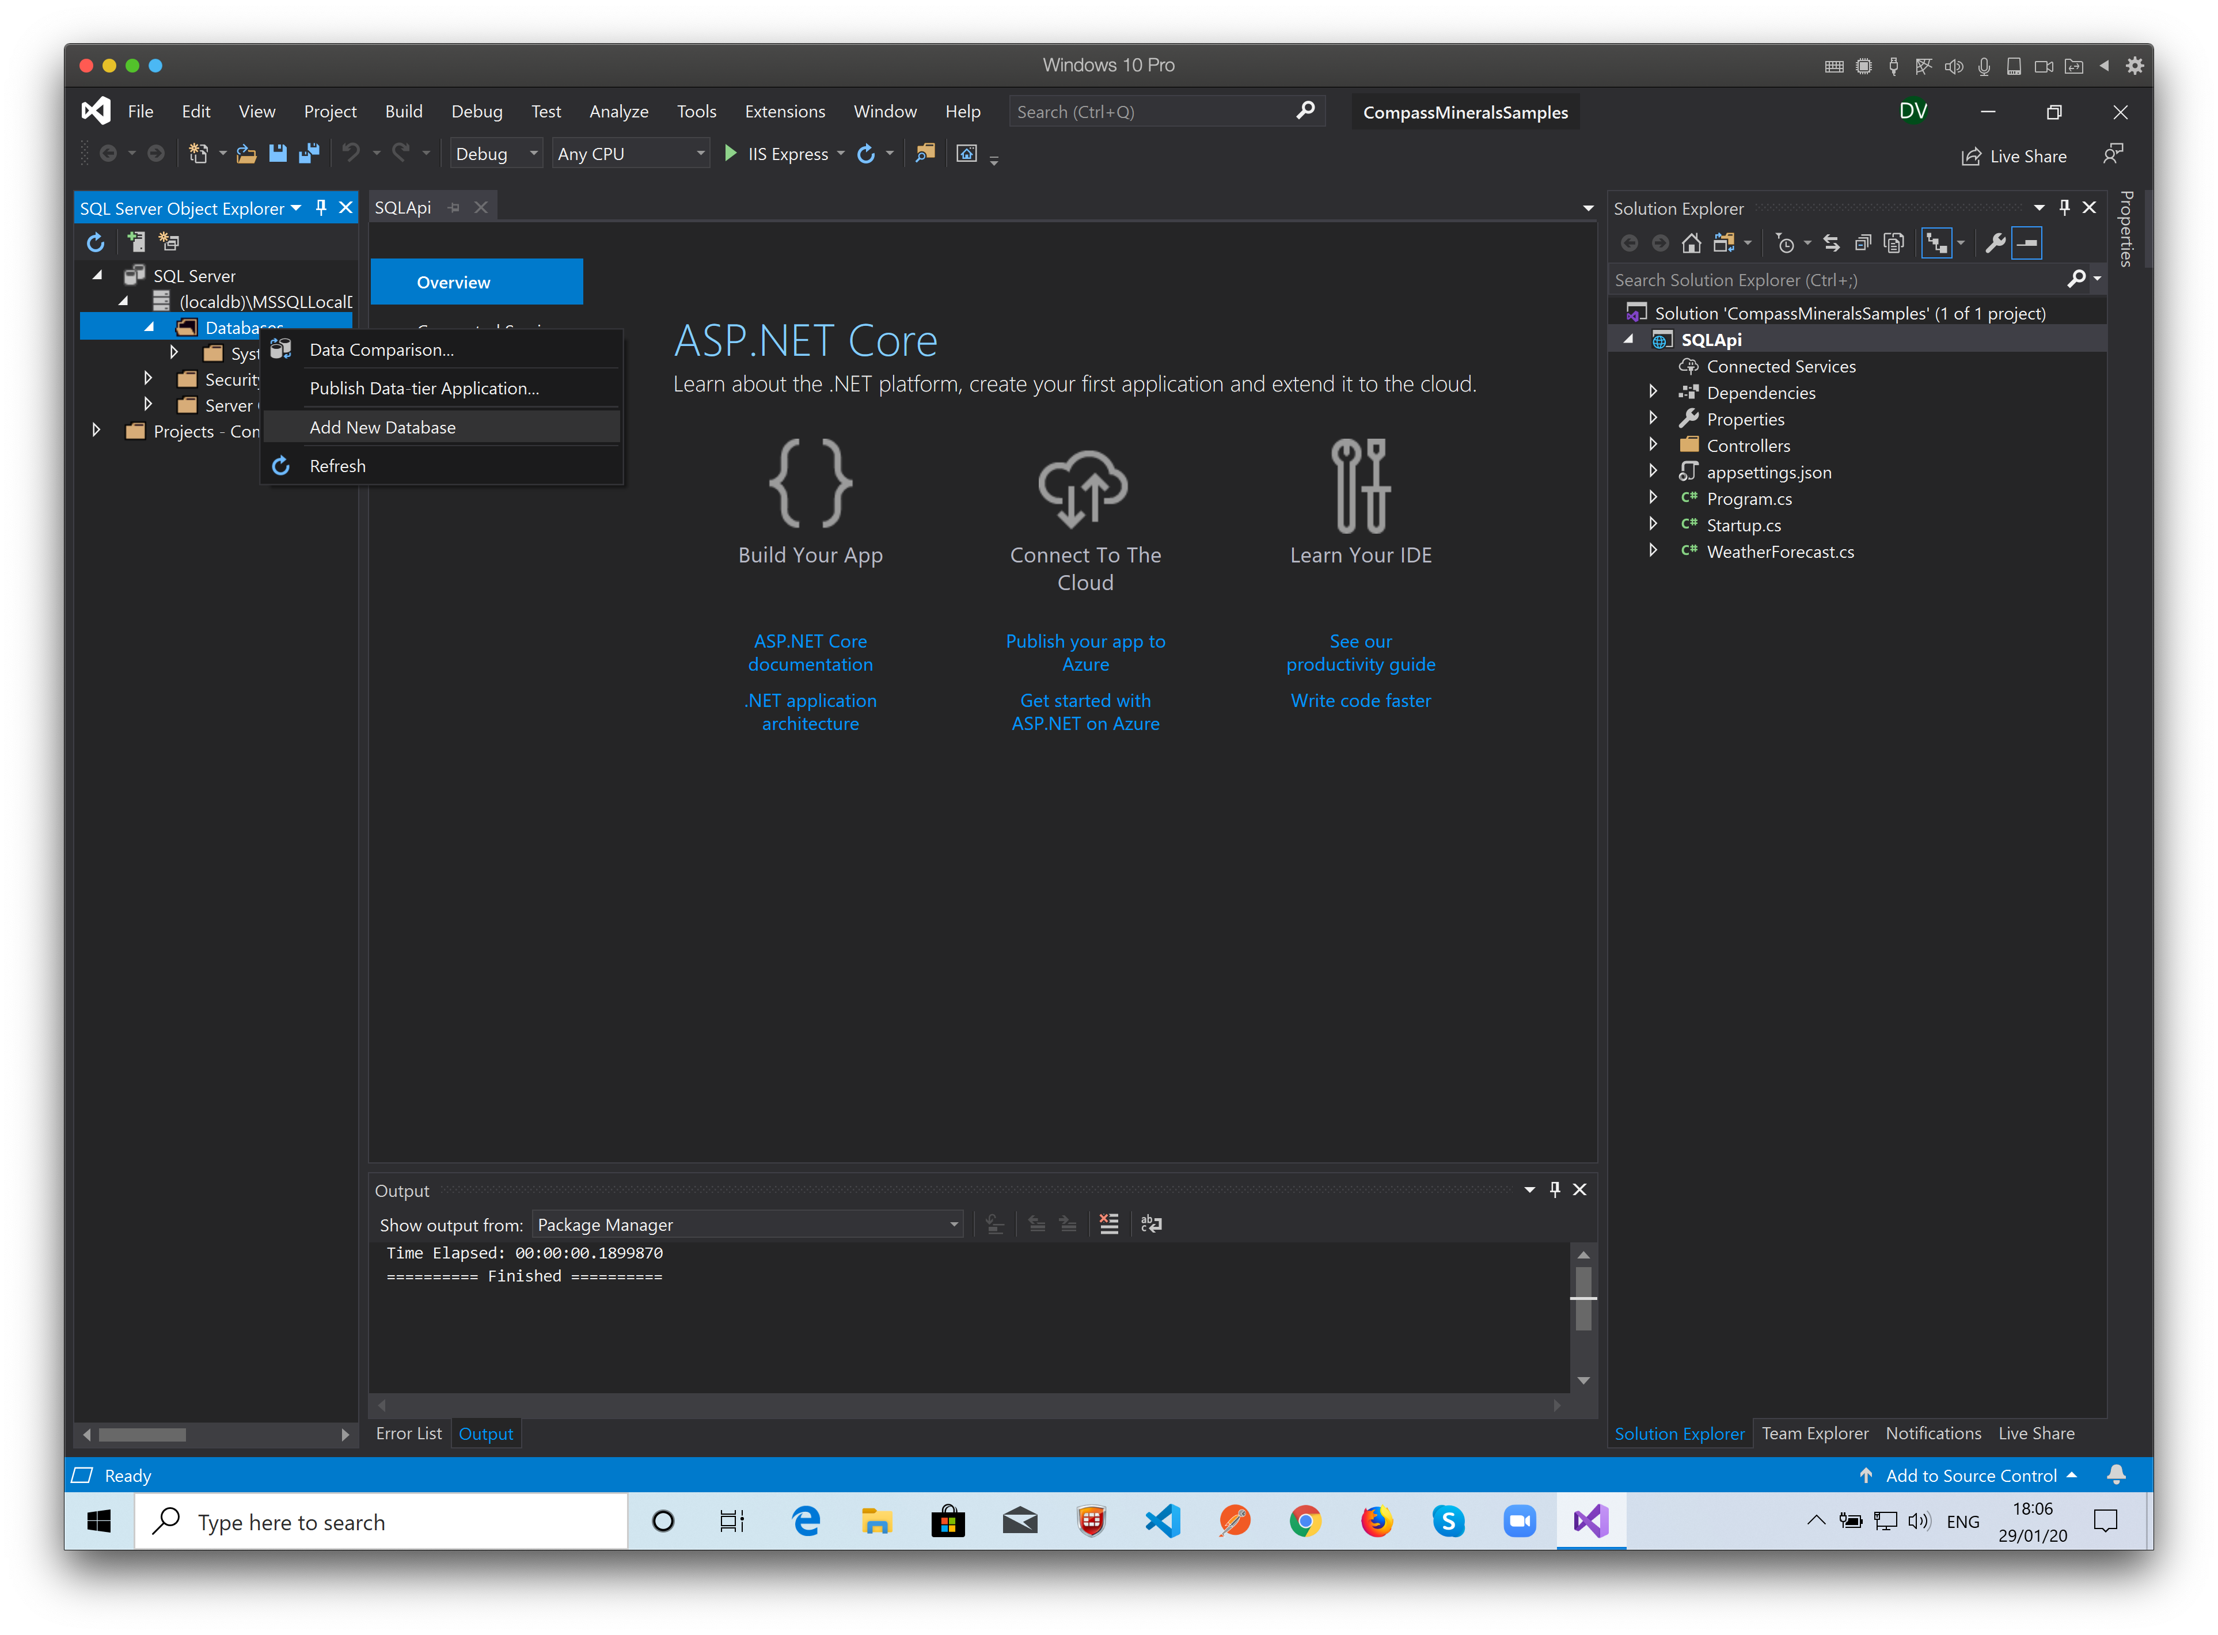
Using the local SQL Instance create a new database.

Slide 9
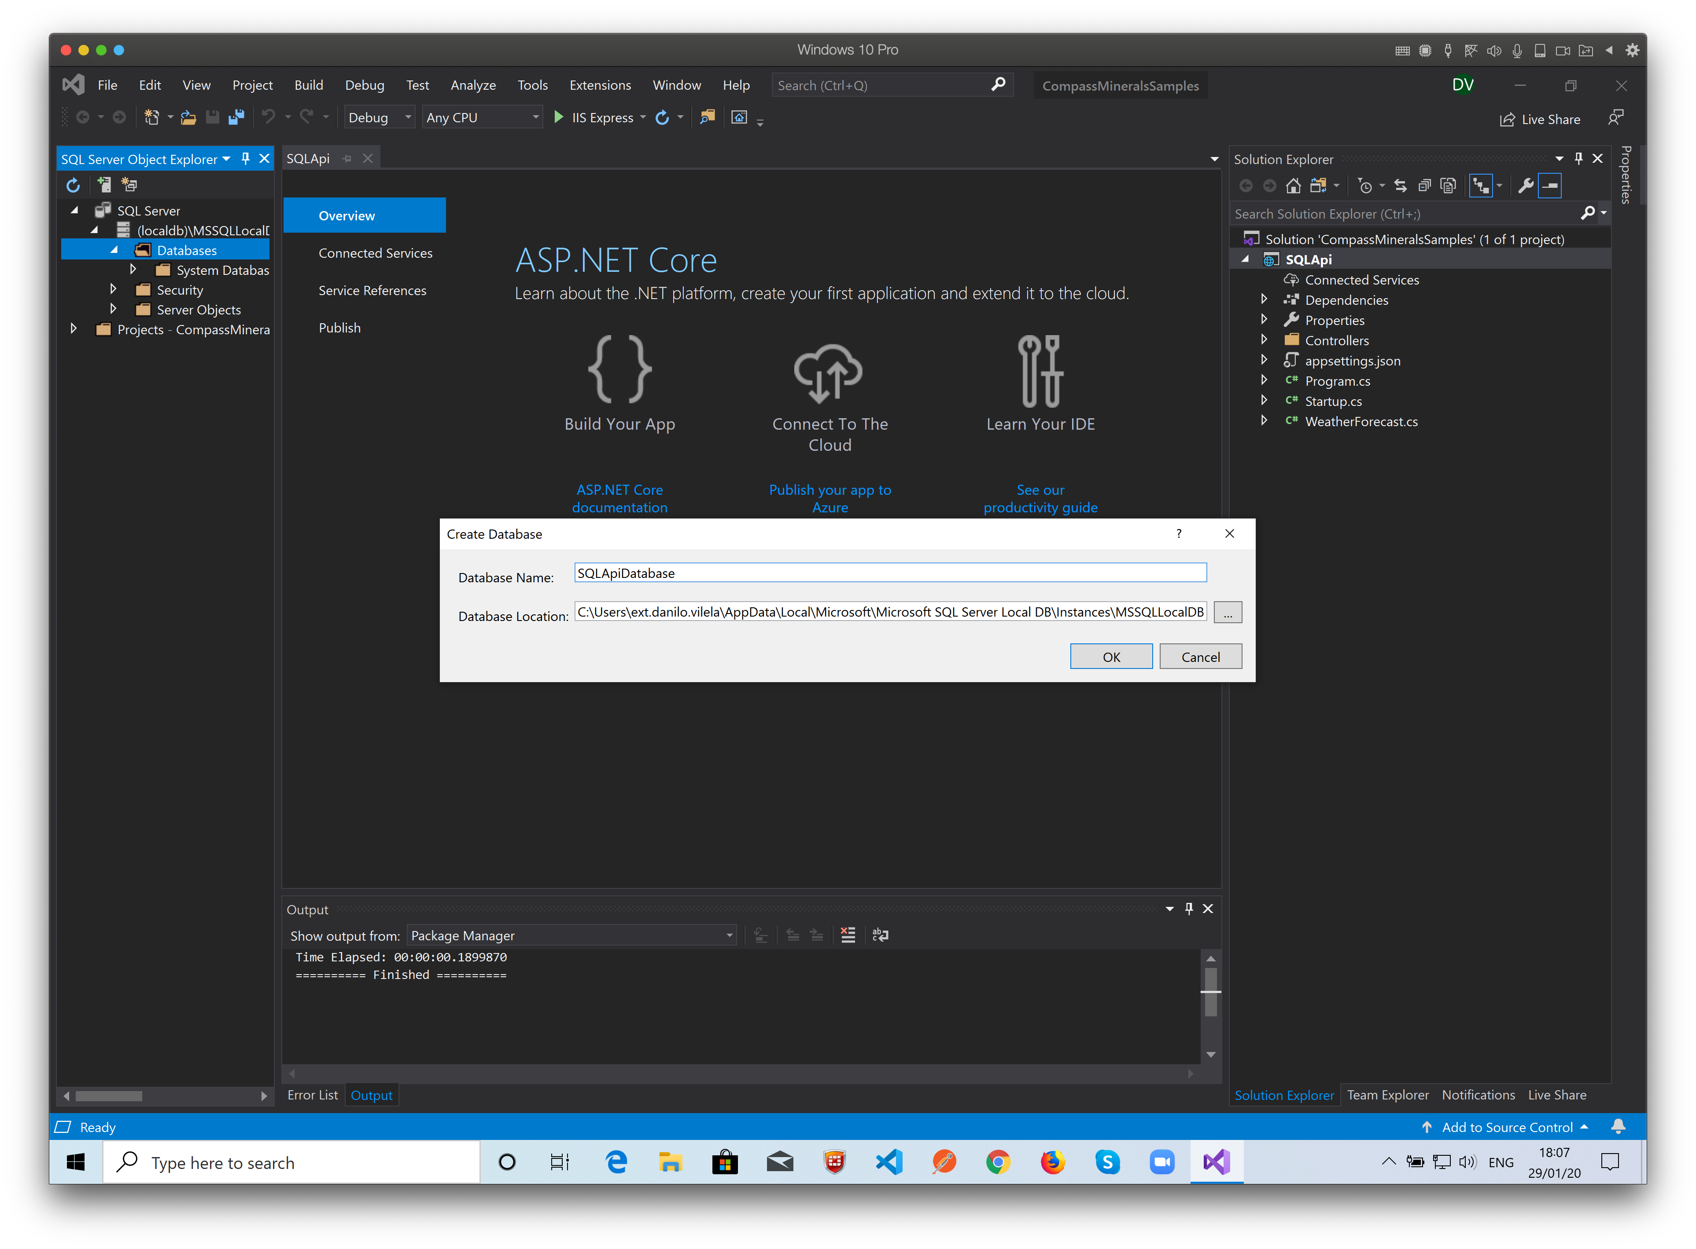
Name it, click “OK” and it’s done!

Slide 10
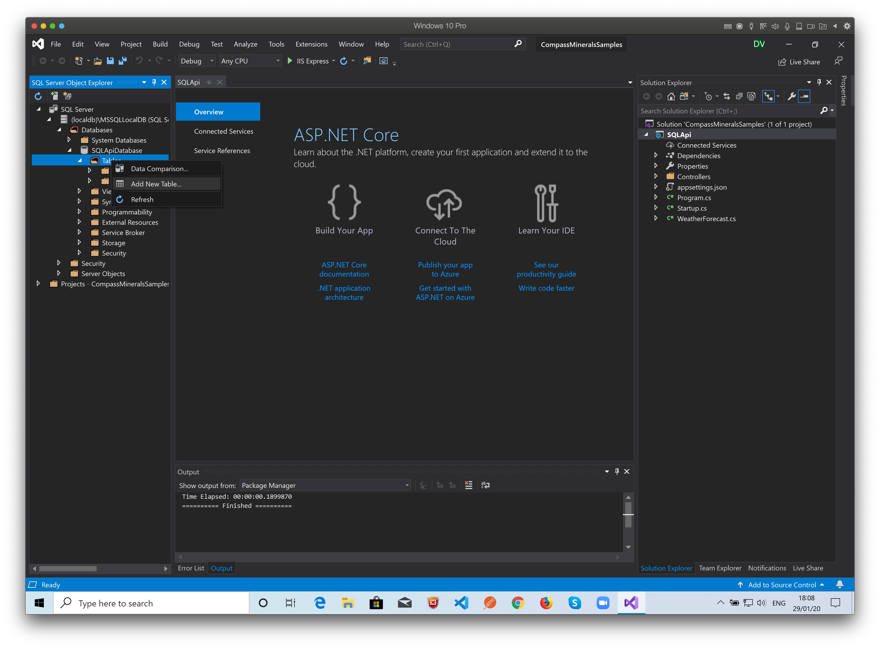
Right click the tables folder to add a new table.

Slide 11
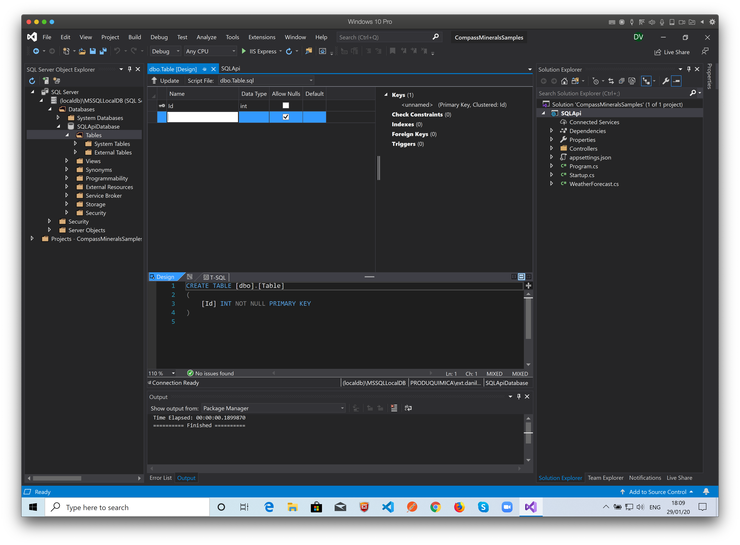
You can add the collumns in this designer window.
Or
Edit the SQL code direct on the TSQ tab.

Slide 12
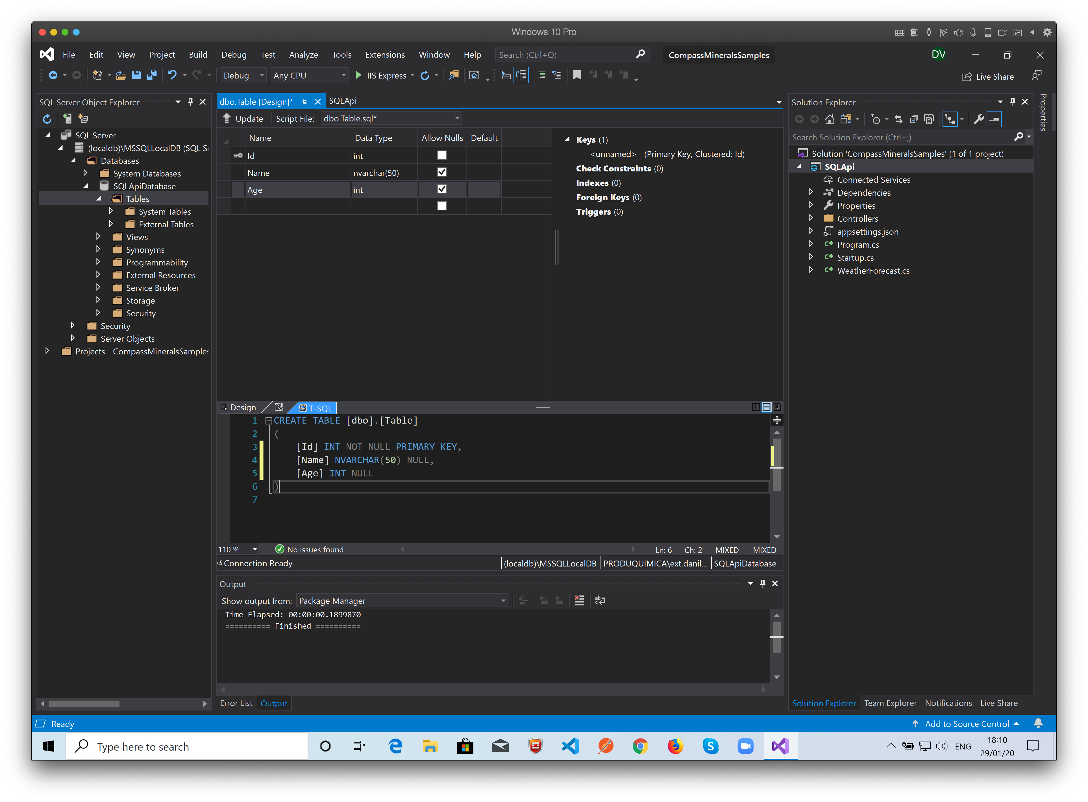
The SQL Code is generated when you’re adding the collumns.
You can save the script to use later.

Slide 13
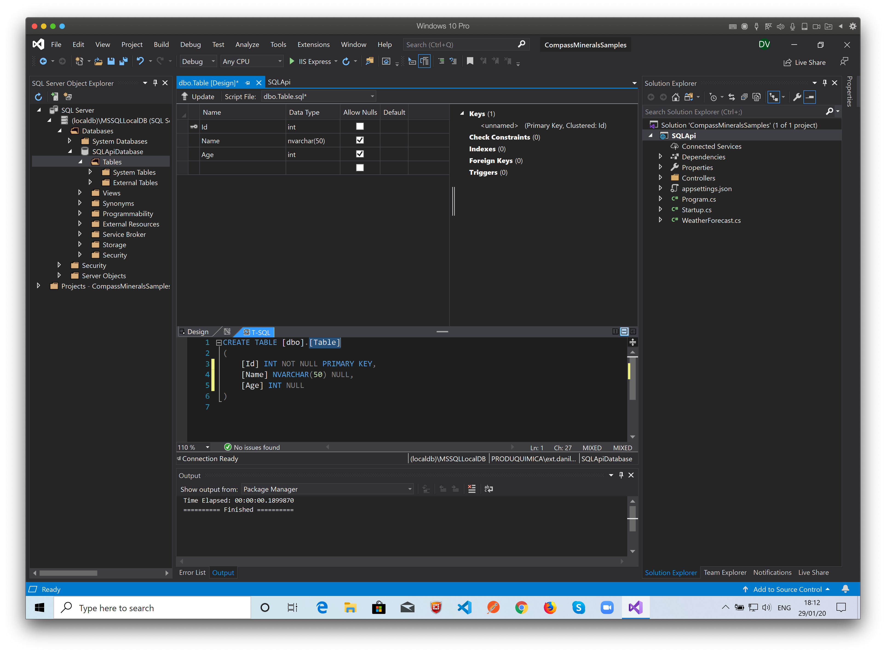
You must change the table name on the code in the T-SQL tab.

Slide 14
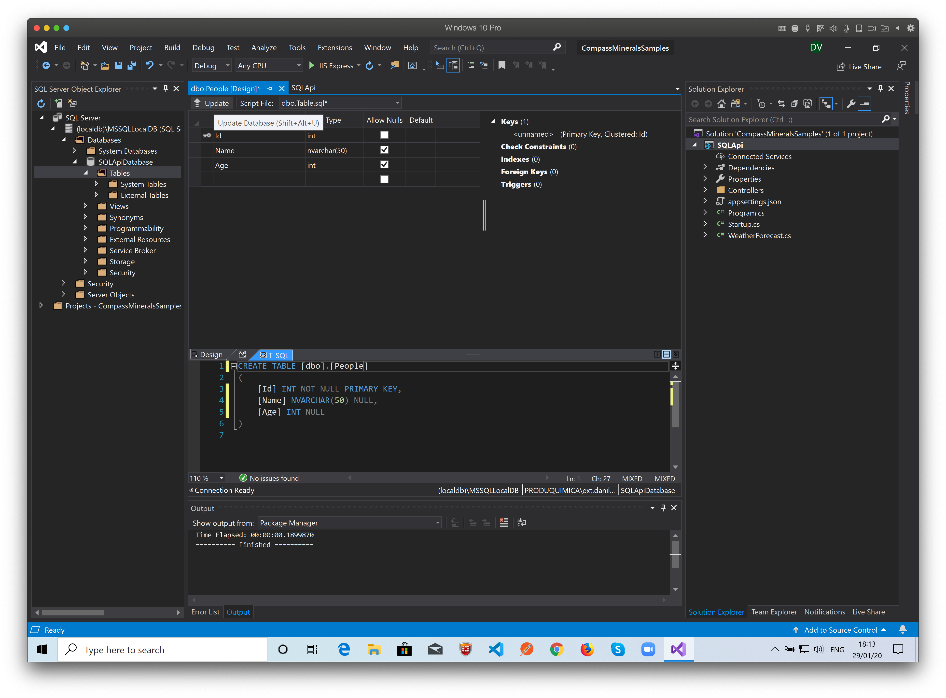
Check the code and click the Update Button.
In this example we created a Table (People) with 3 Collums (Id, Name, Age) with Id as a primary Key no identity.

Slide 15
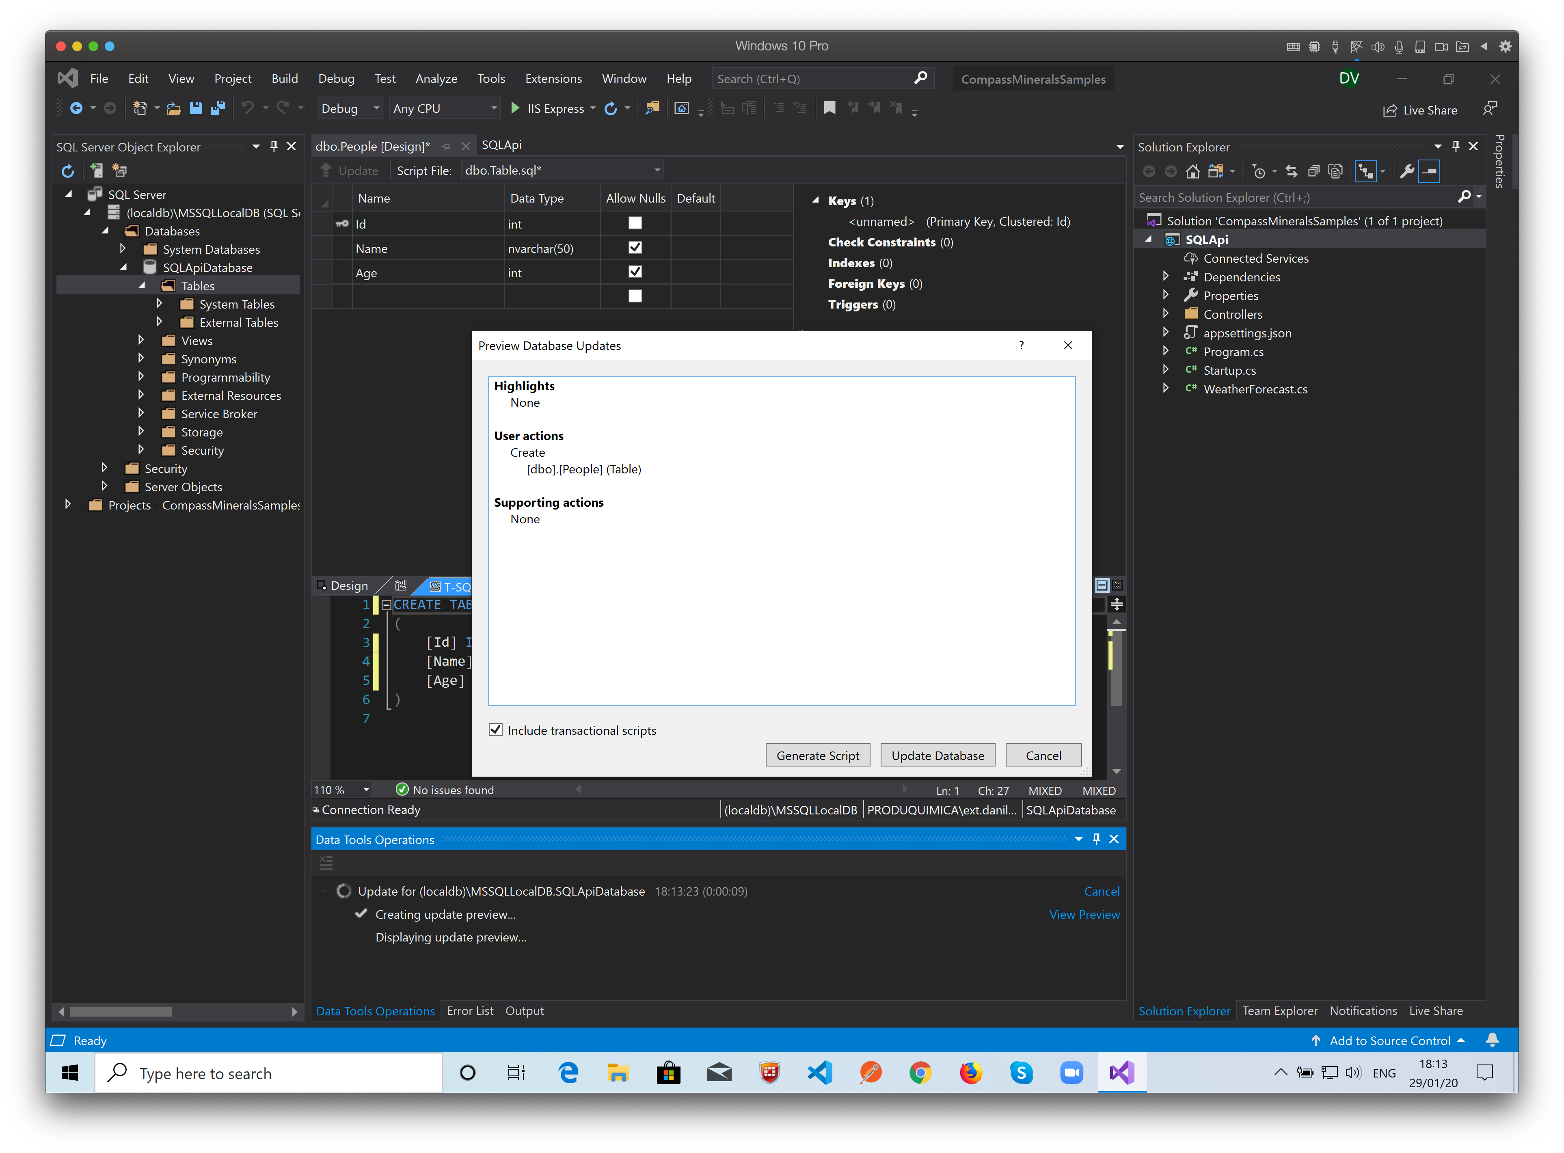
Confirm the actions and click on “Update Database”
Next we’ll add records to our table.

Slide 16
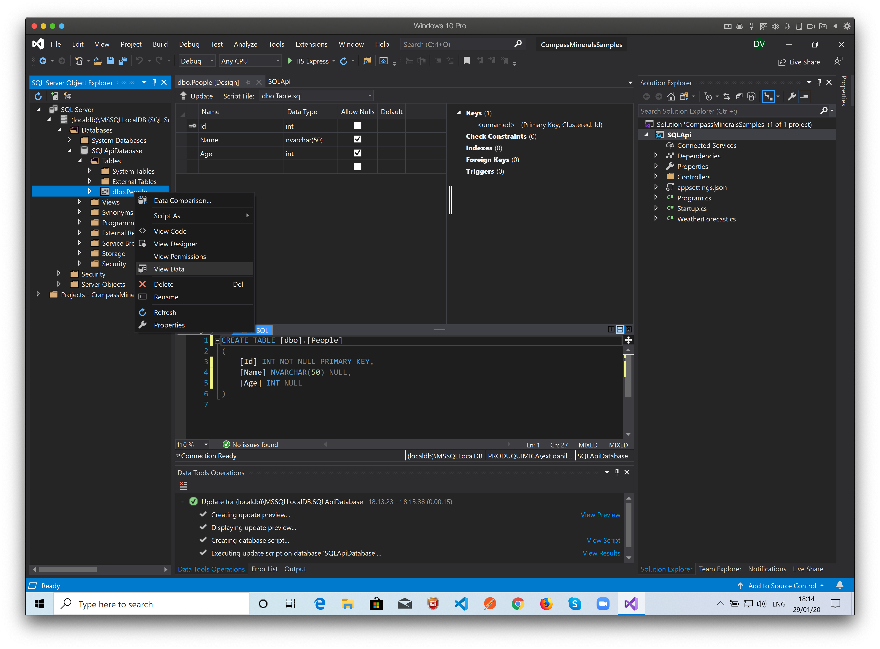
Right Click the table and select “View Data” – Another design window will open…

Slide 17
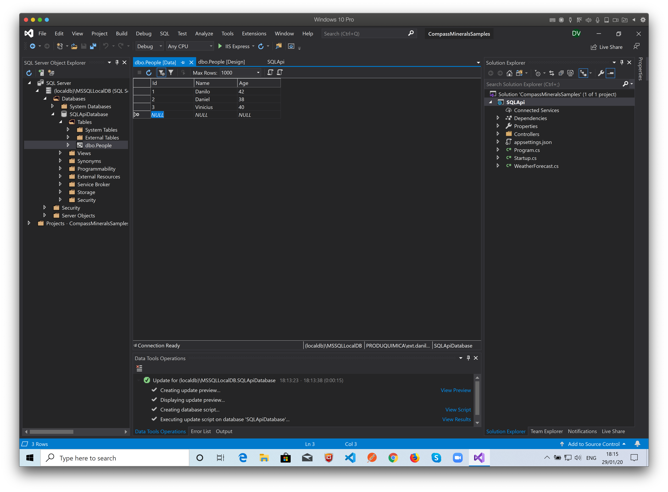
Here you can add, update and delete records on the People table…

Slide 18
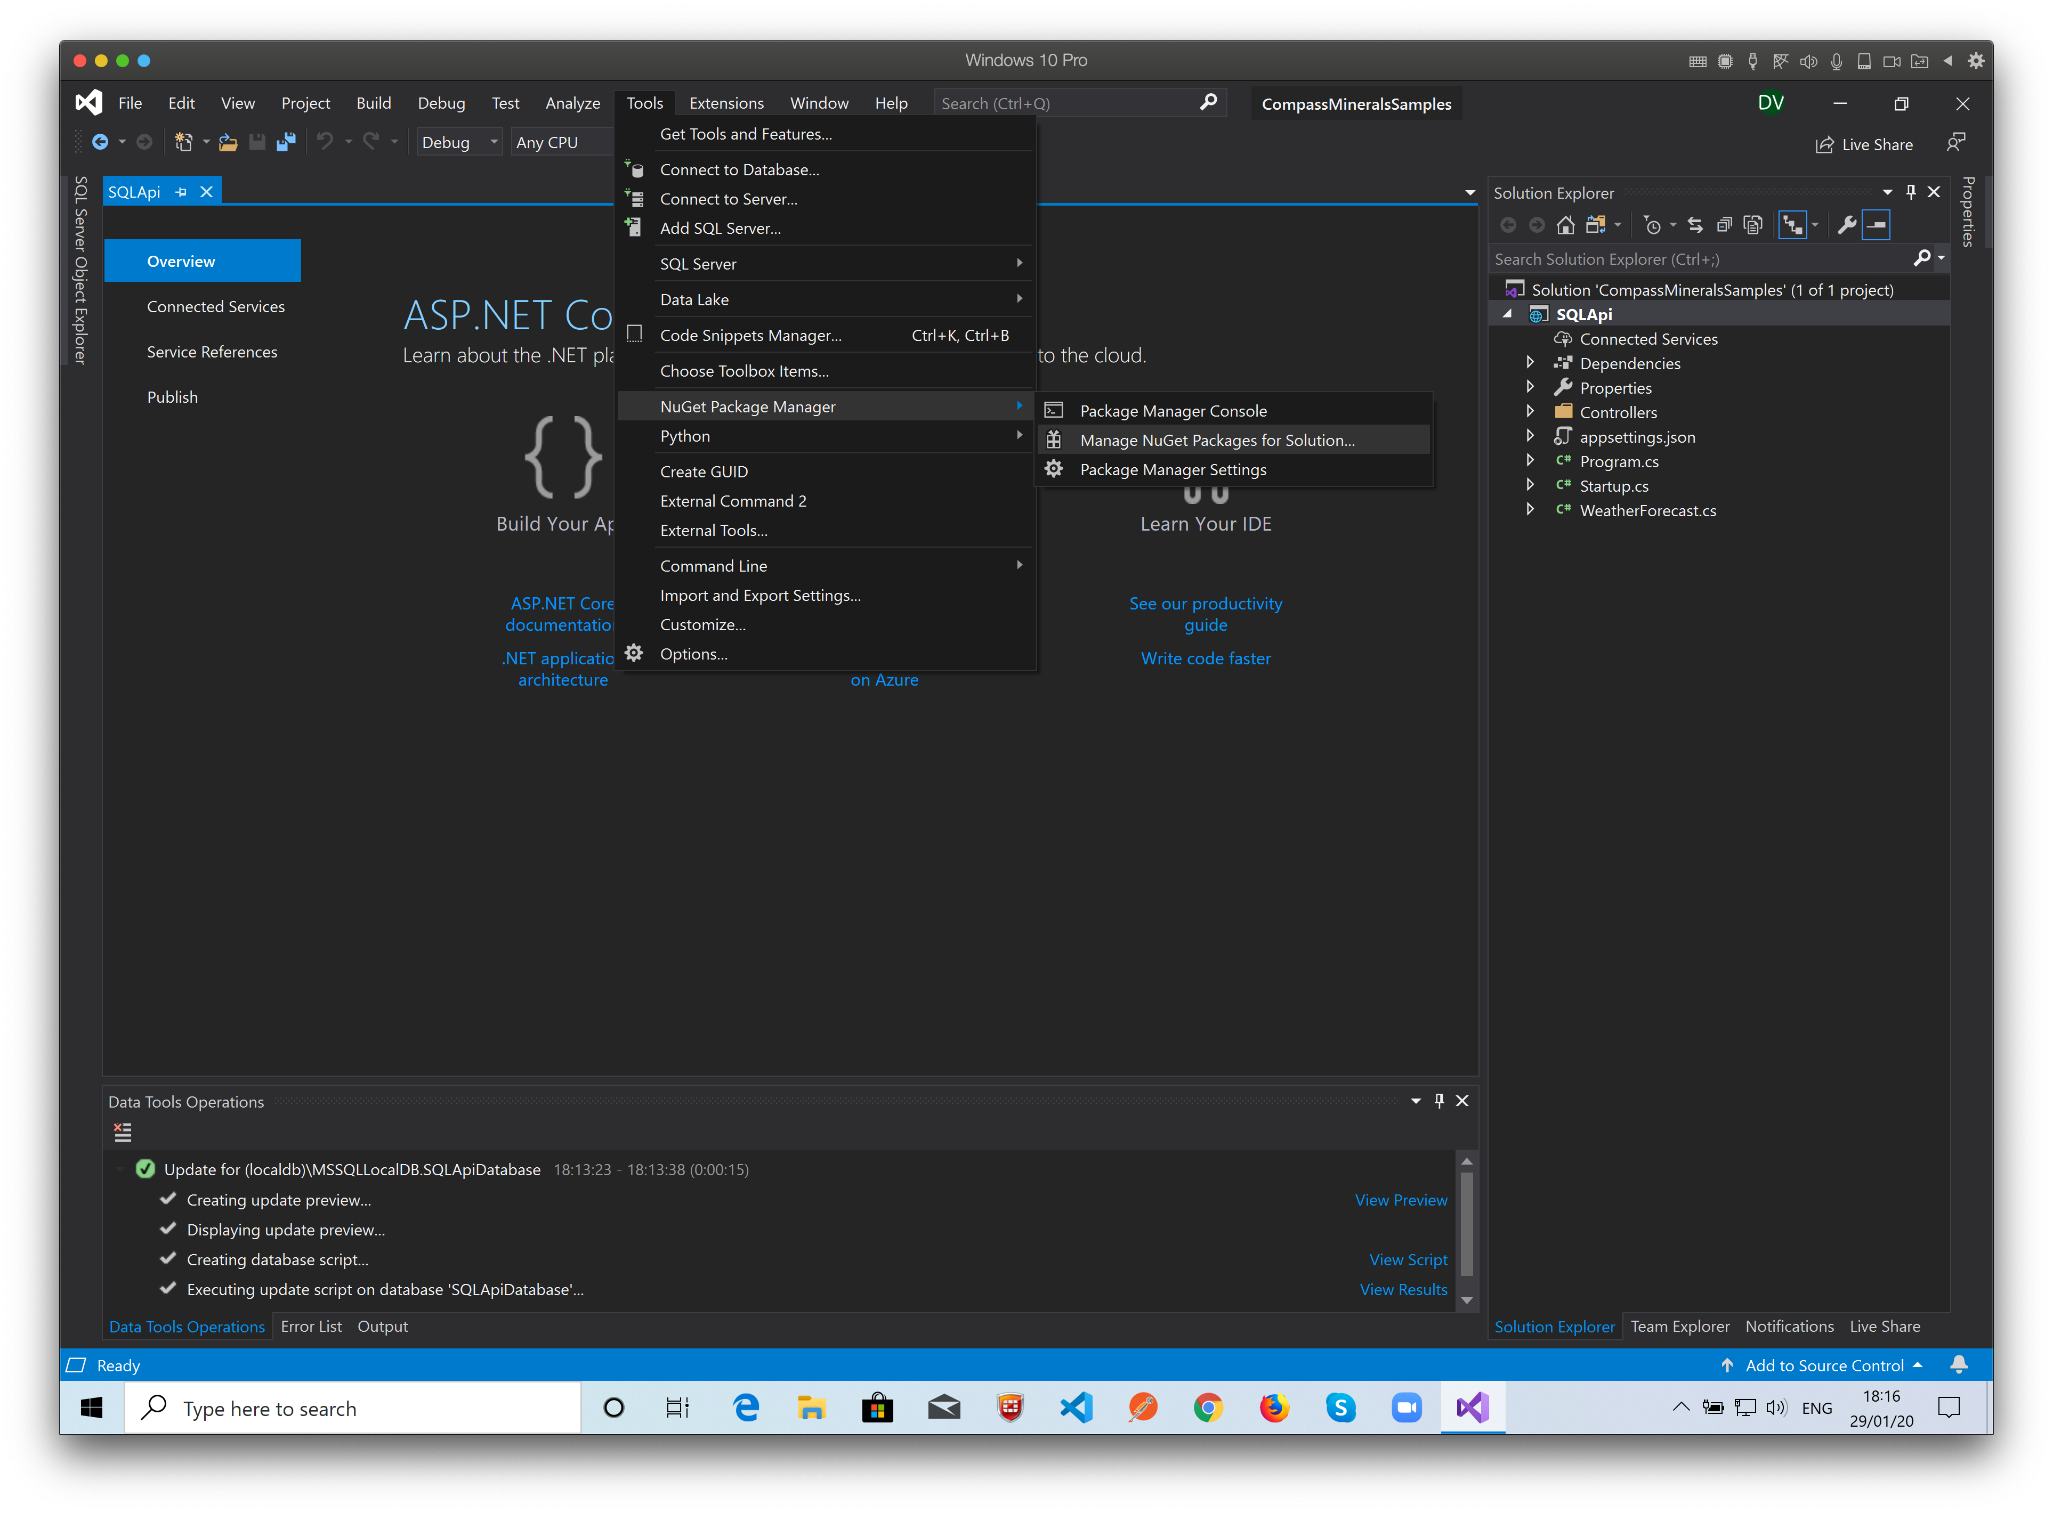
Here the fun begins…
We’ll prepare the project to connect to the database, create, read, update and delete records. To do that, we need to install the Entity Framework libraries on the project before we do any code.
The dependencies manager on Visual Studio is the Nuget Packages Manager.
To open it Select Tools -> NuGet Package Manager -> Manage NuGet Packages for Solution…

Slide 19
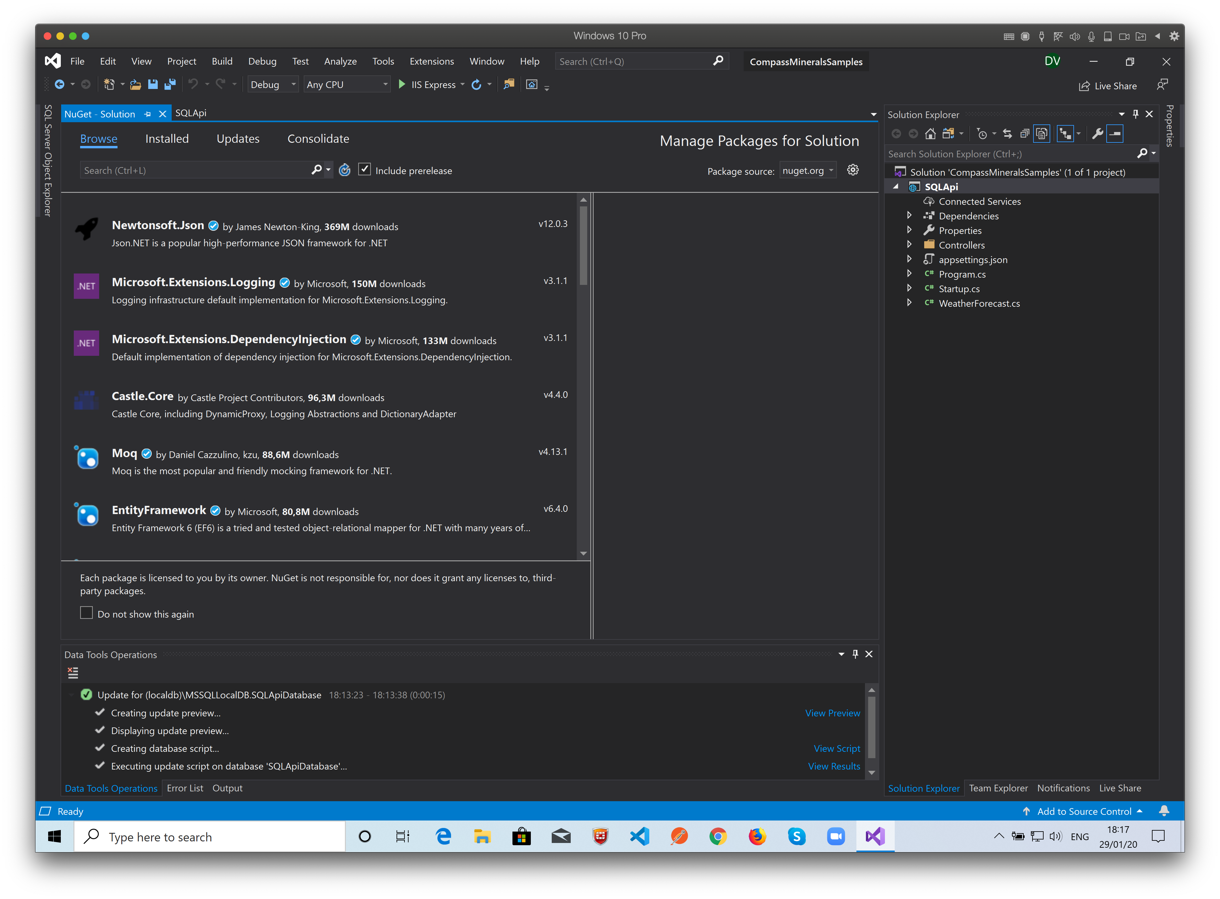
Here it is…
Click “Browse” and on the search field, type “entityframeworkcore”…

Slide 20
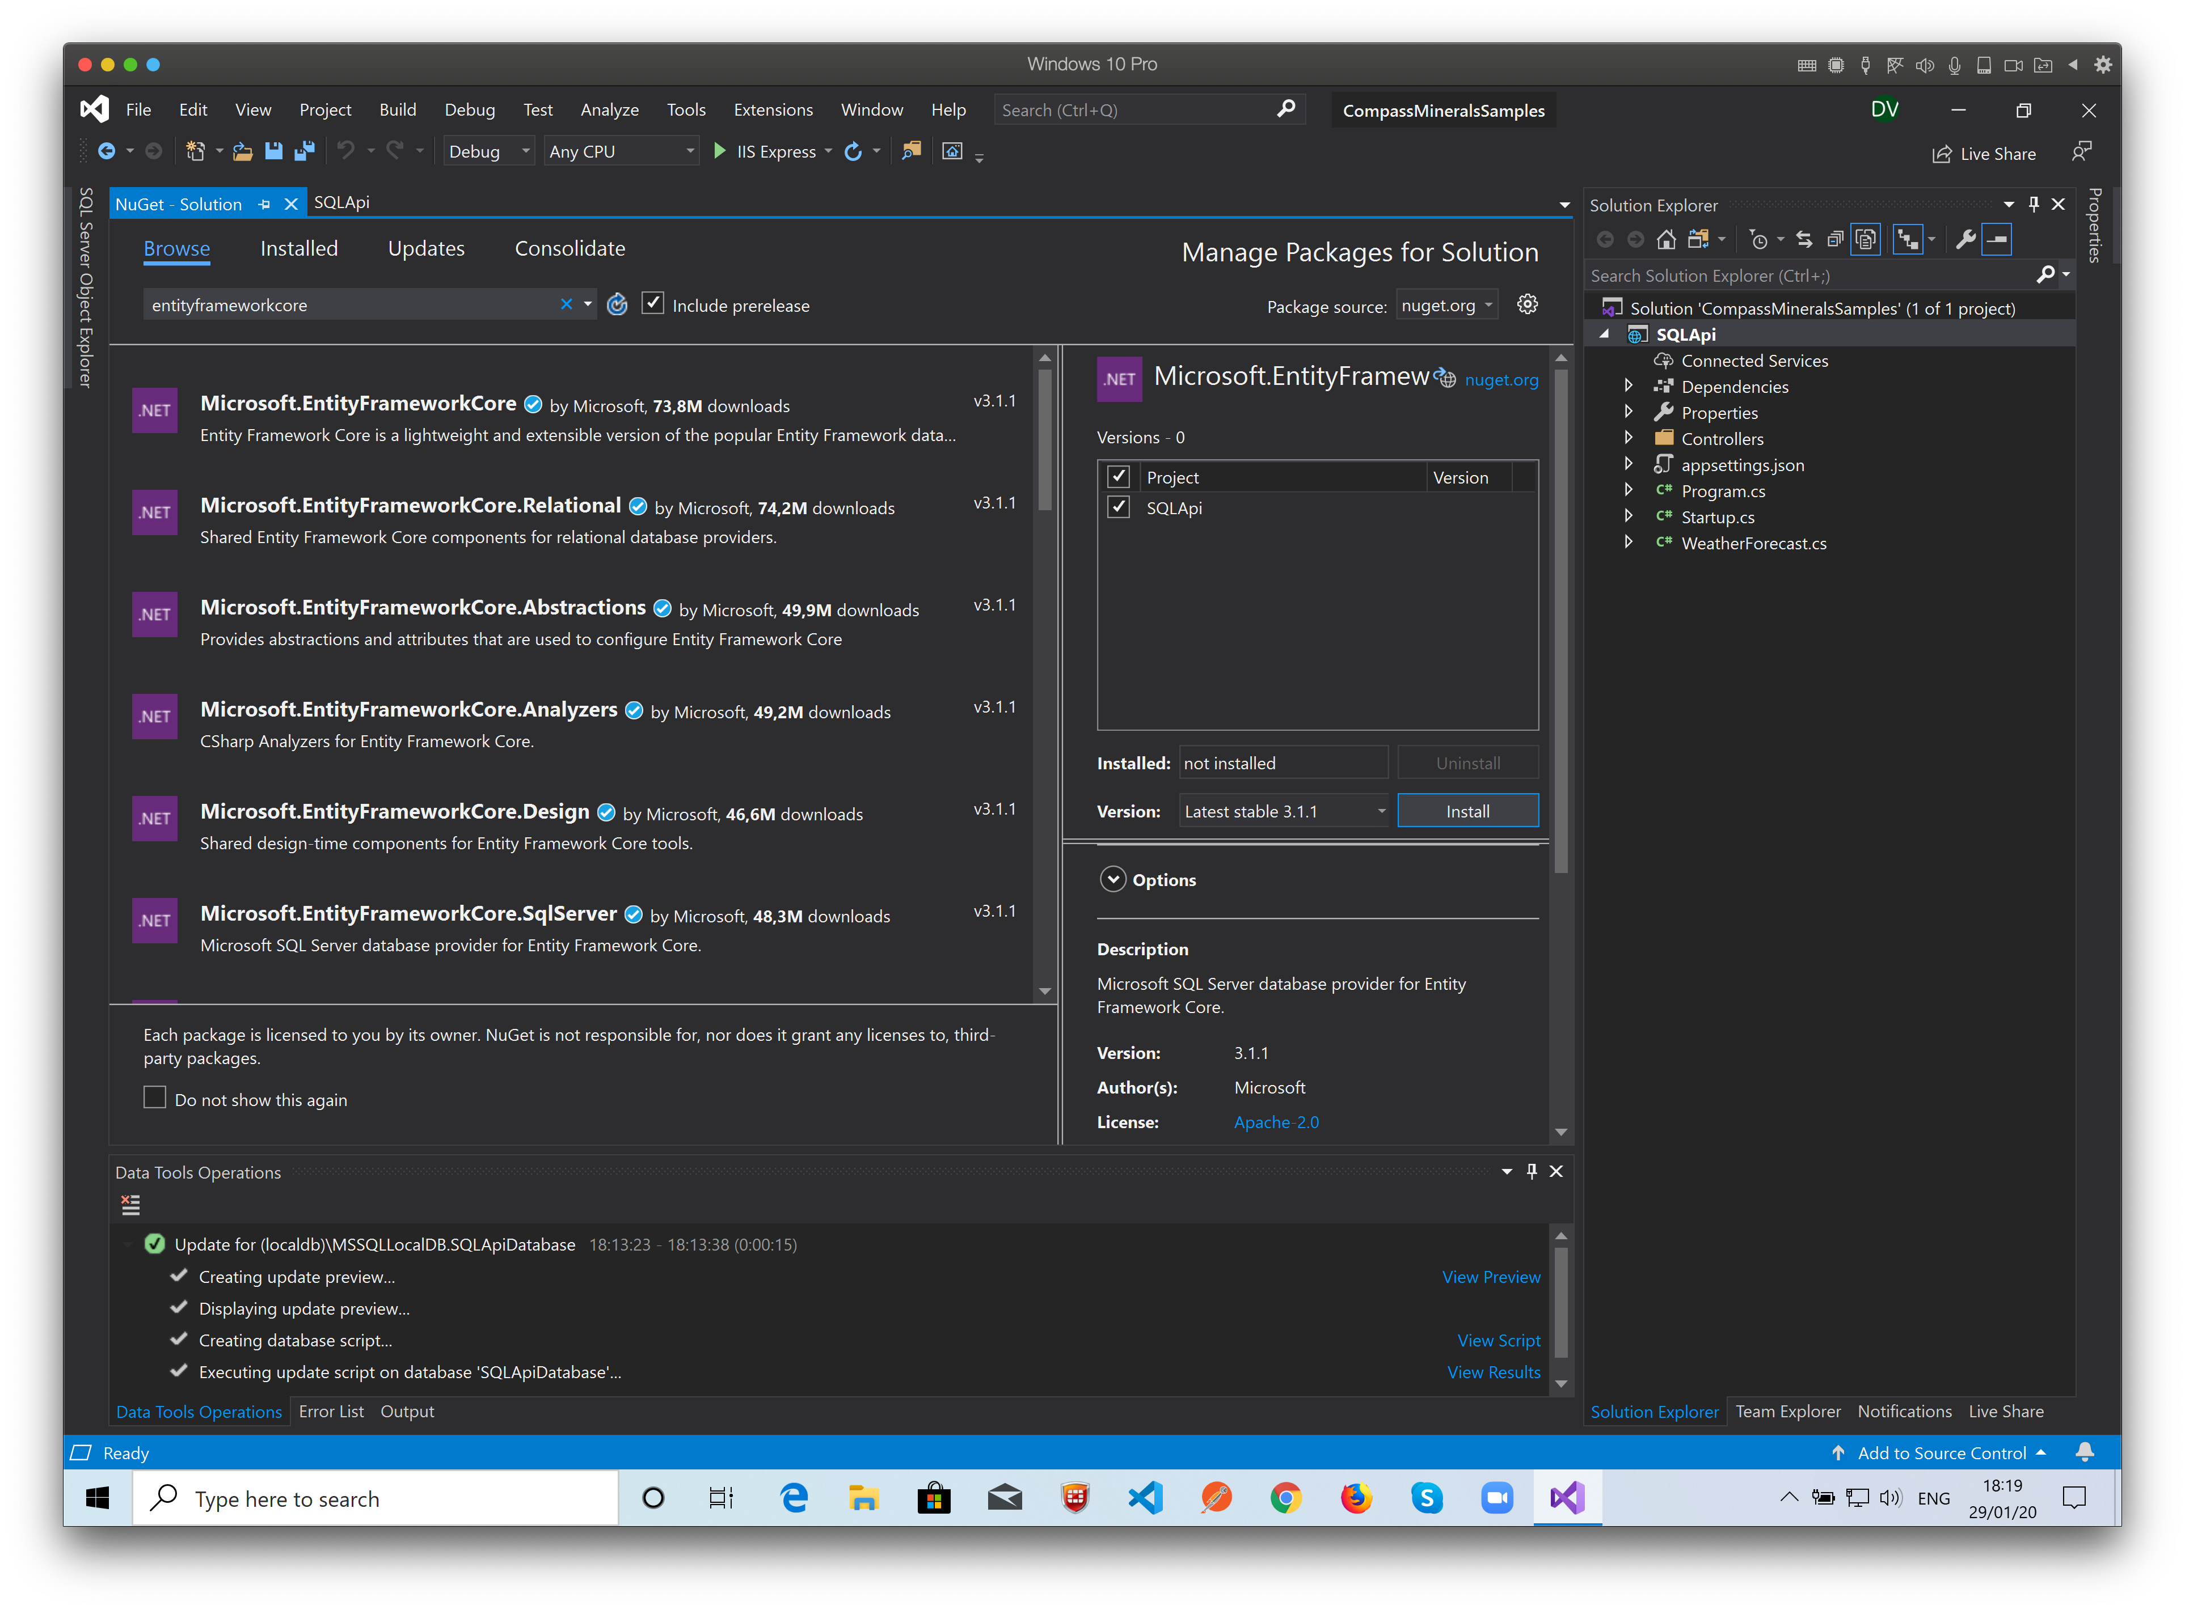
Now…
Select “Microsoft.EntityFrameworkCore”,
Mark the destination project(s) checkbox.
Click Install

Slide 21
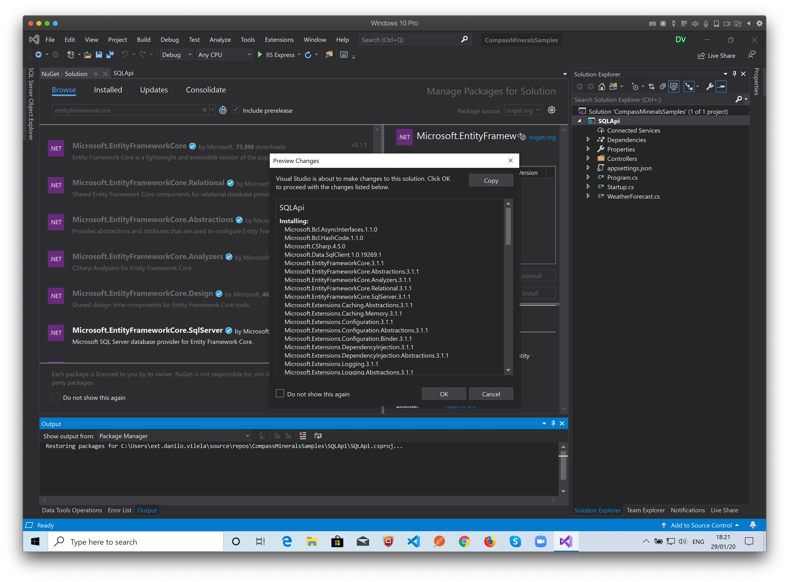
Click “OK”. All the dependencies for the Entity Framework will be downloaded and installed on the project.

Slide 22
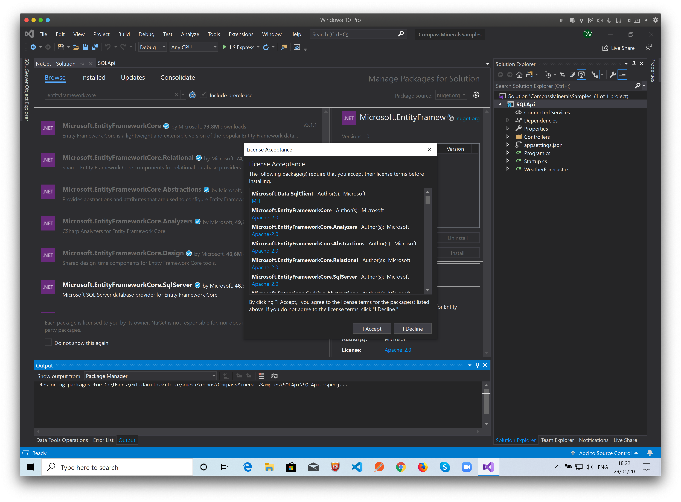
You must accept the licenses...

Slide 23
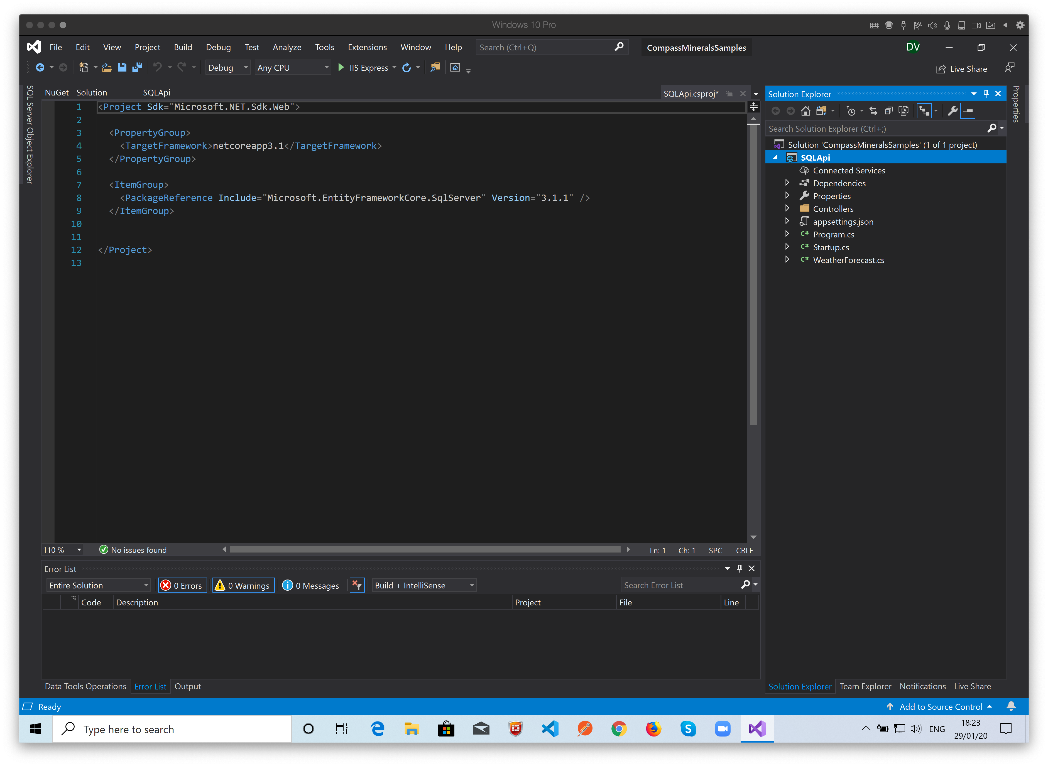
You can see the project definition file changes made by the NuGet Package Manager...

Slide 24
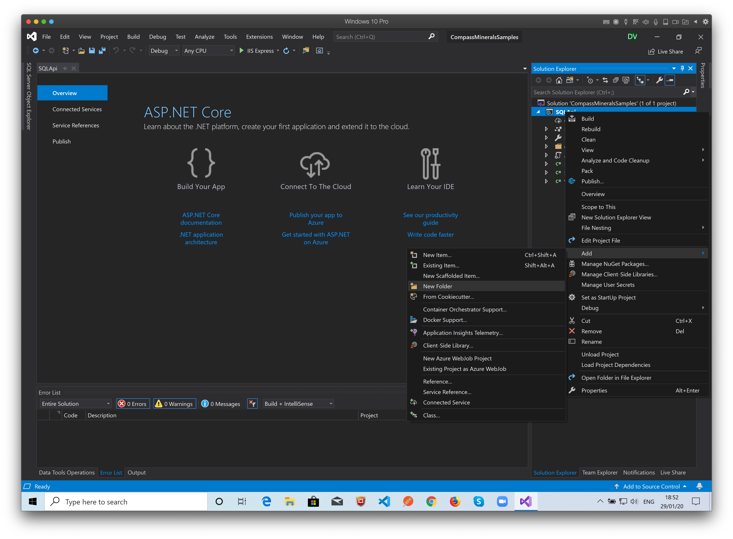
We’ll need to create some folders and classes to manipulate the database with Entity Framework…
** The code for each step is on the “Complete Code changes.cs” file. The comments indicate the related slides.
Right Click the project and select: Add -> New Folder

Slide 25
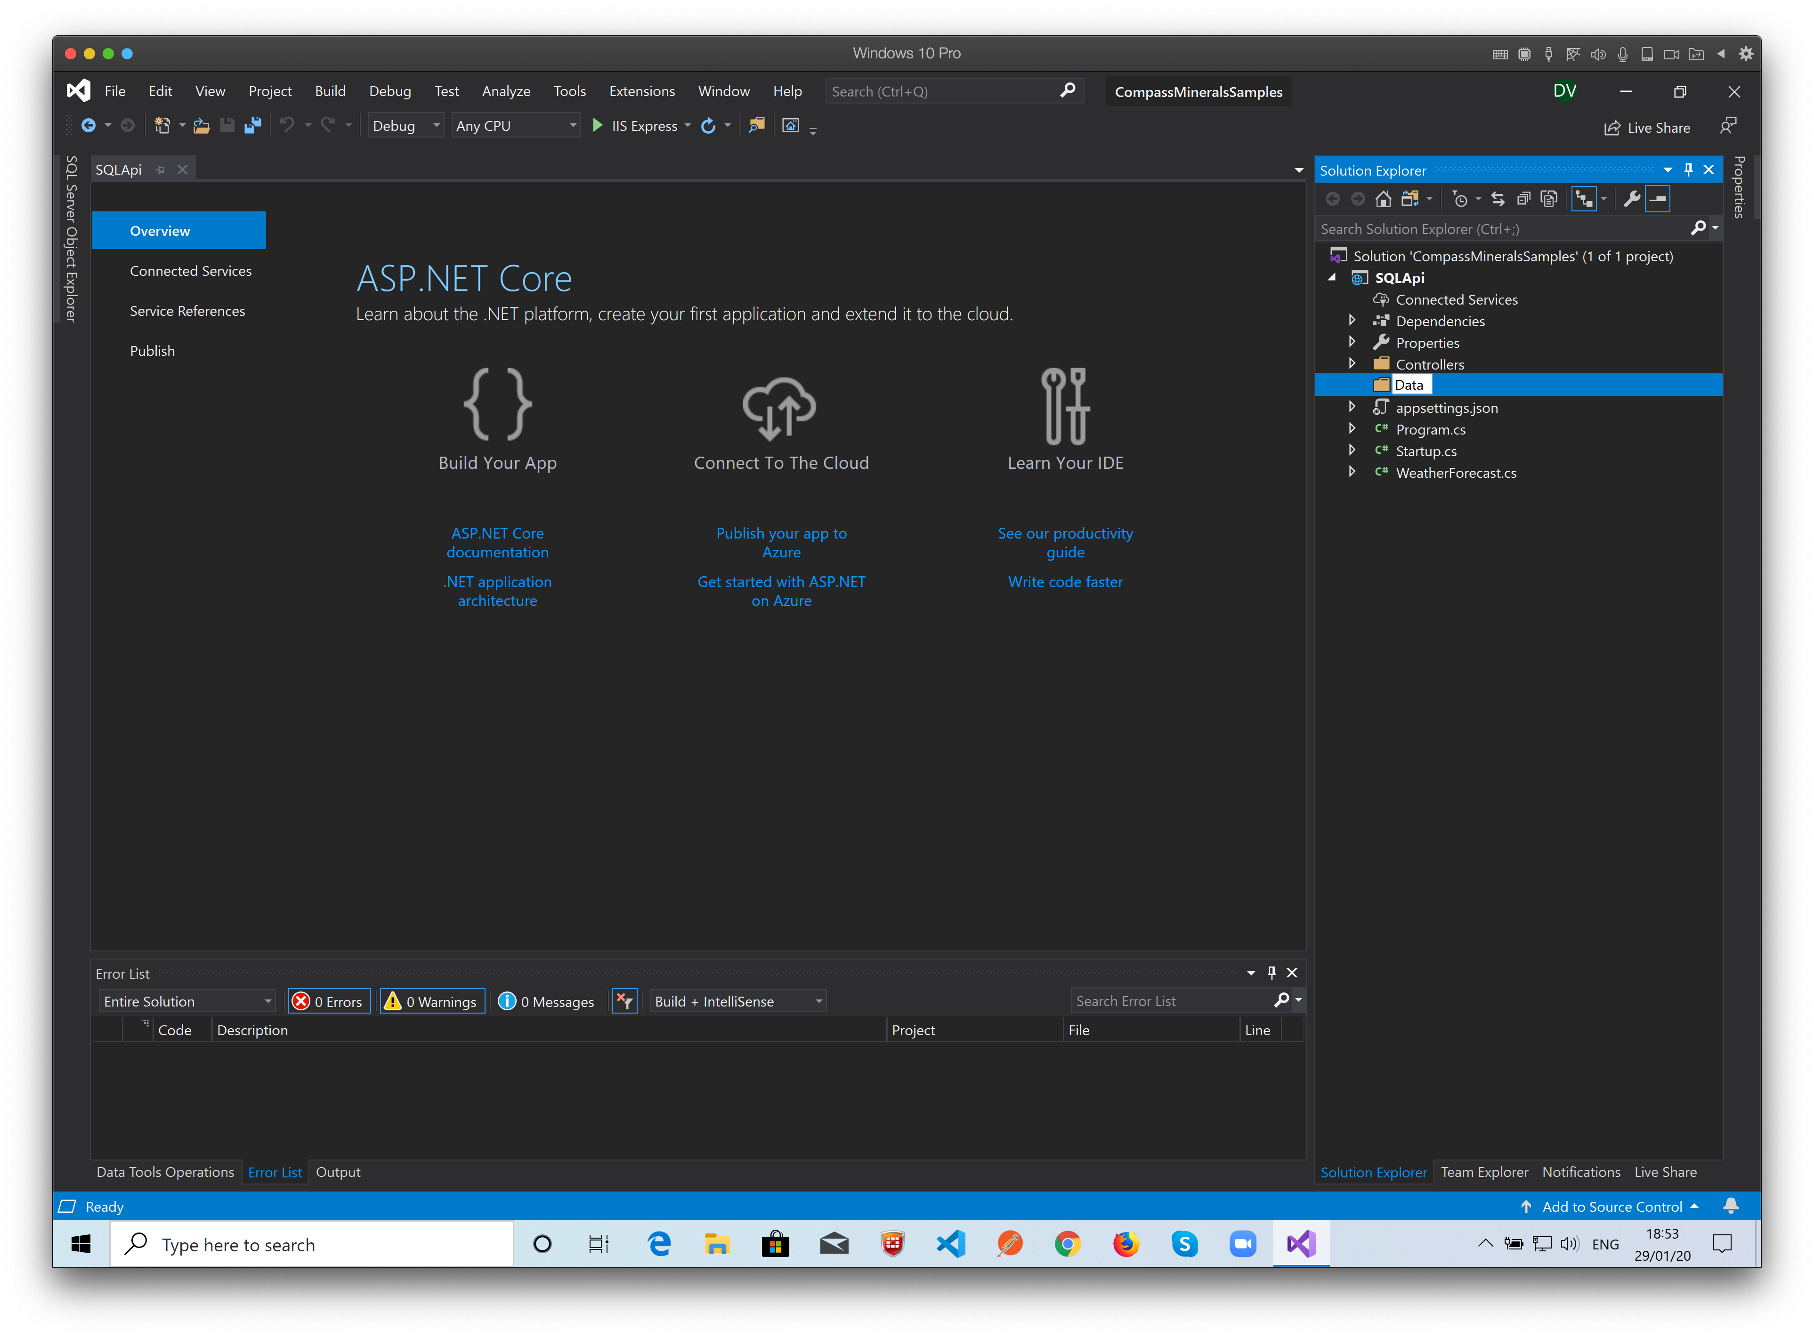
Name it “Data”…

Slide 26
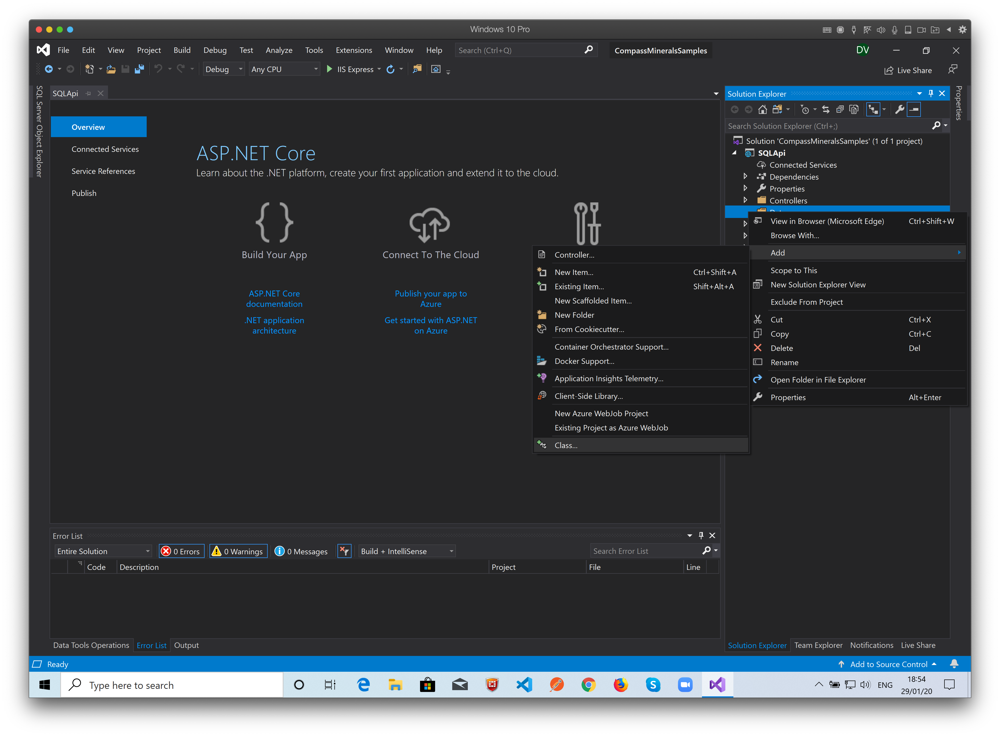
Right click the Data folder and select: Add -> Class…

Slide 27
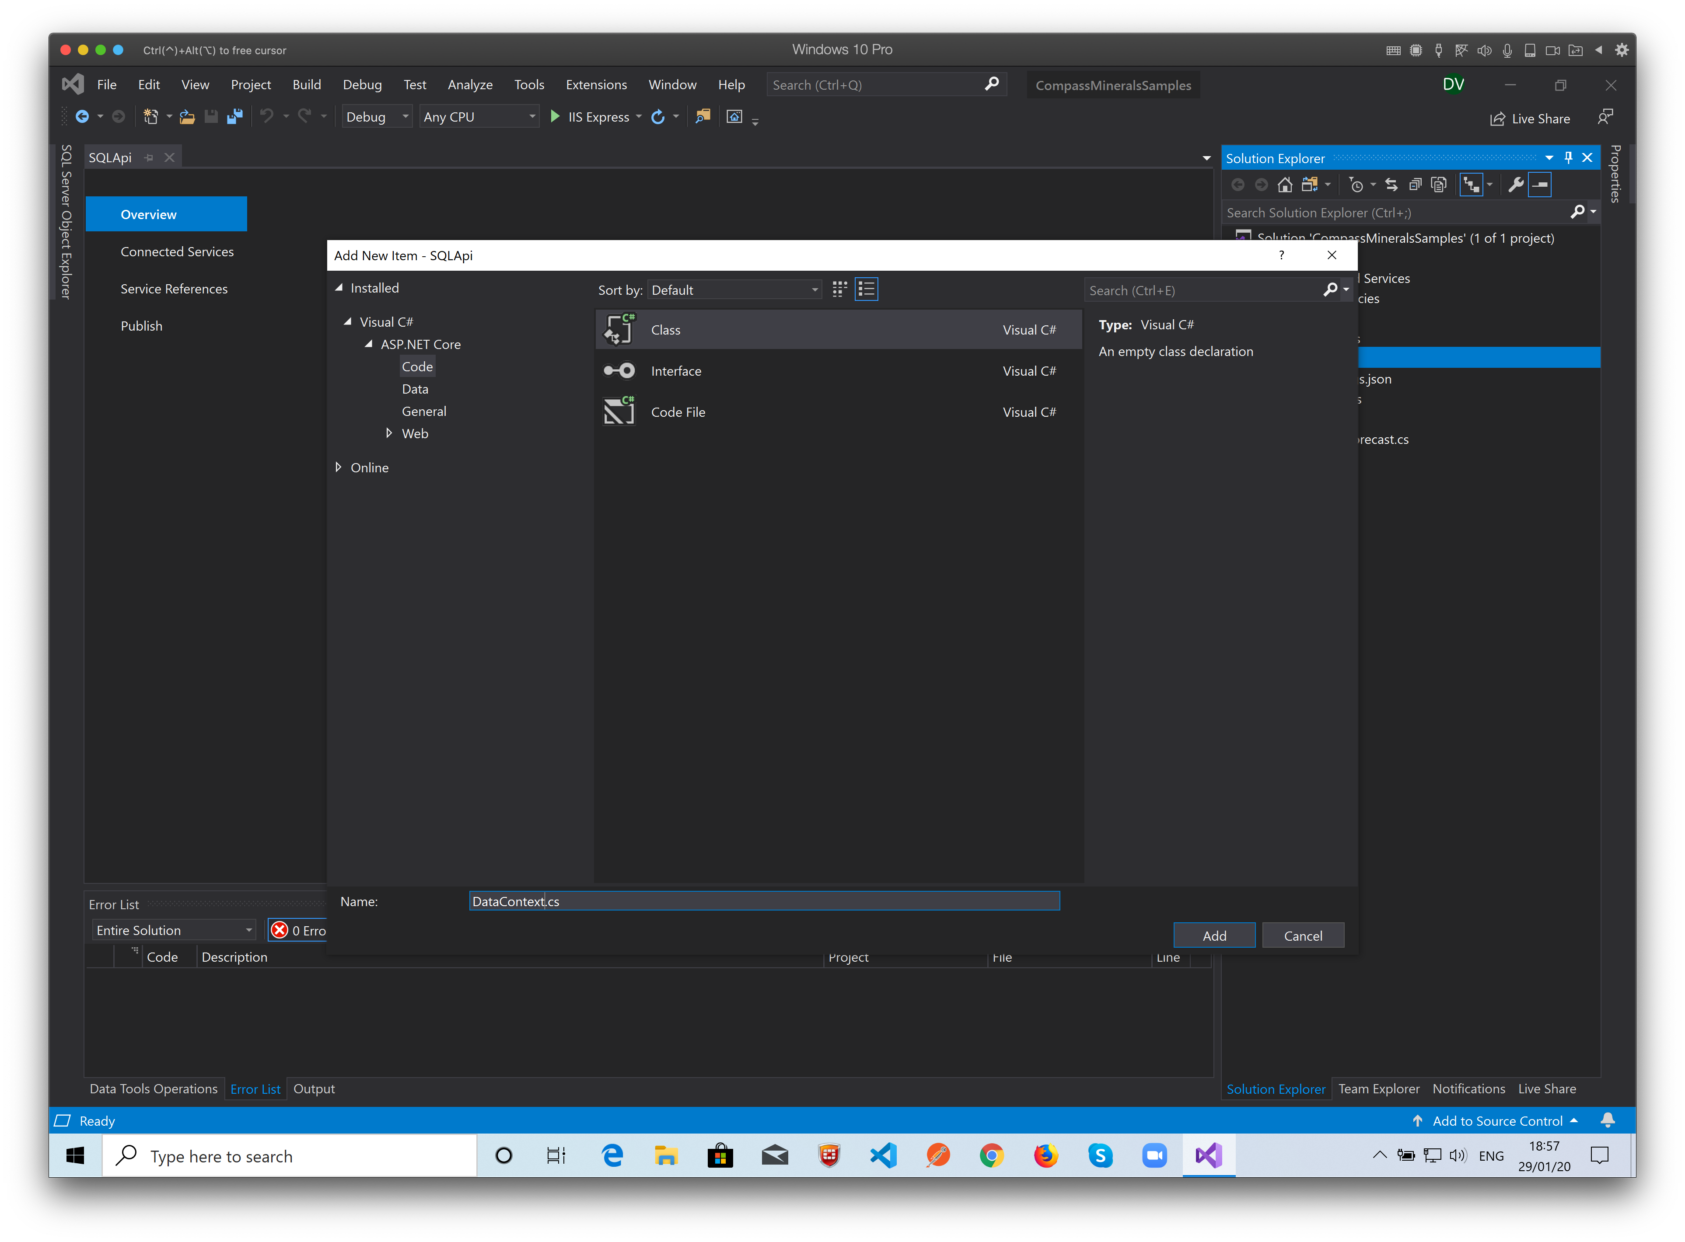
Name it “DataContext.cs” and click Add…

Slide 28
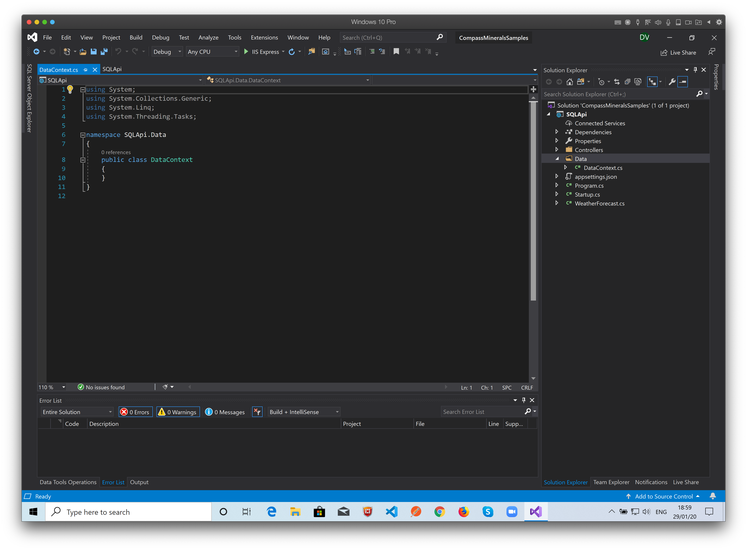
In this class we’ll add the code to configure the database context to the entity framework.

Slide 29
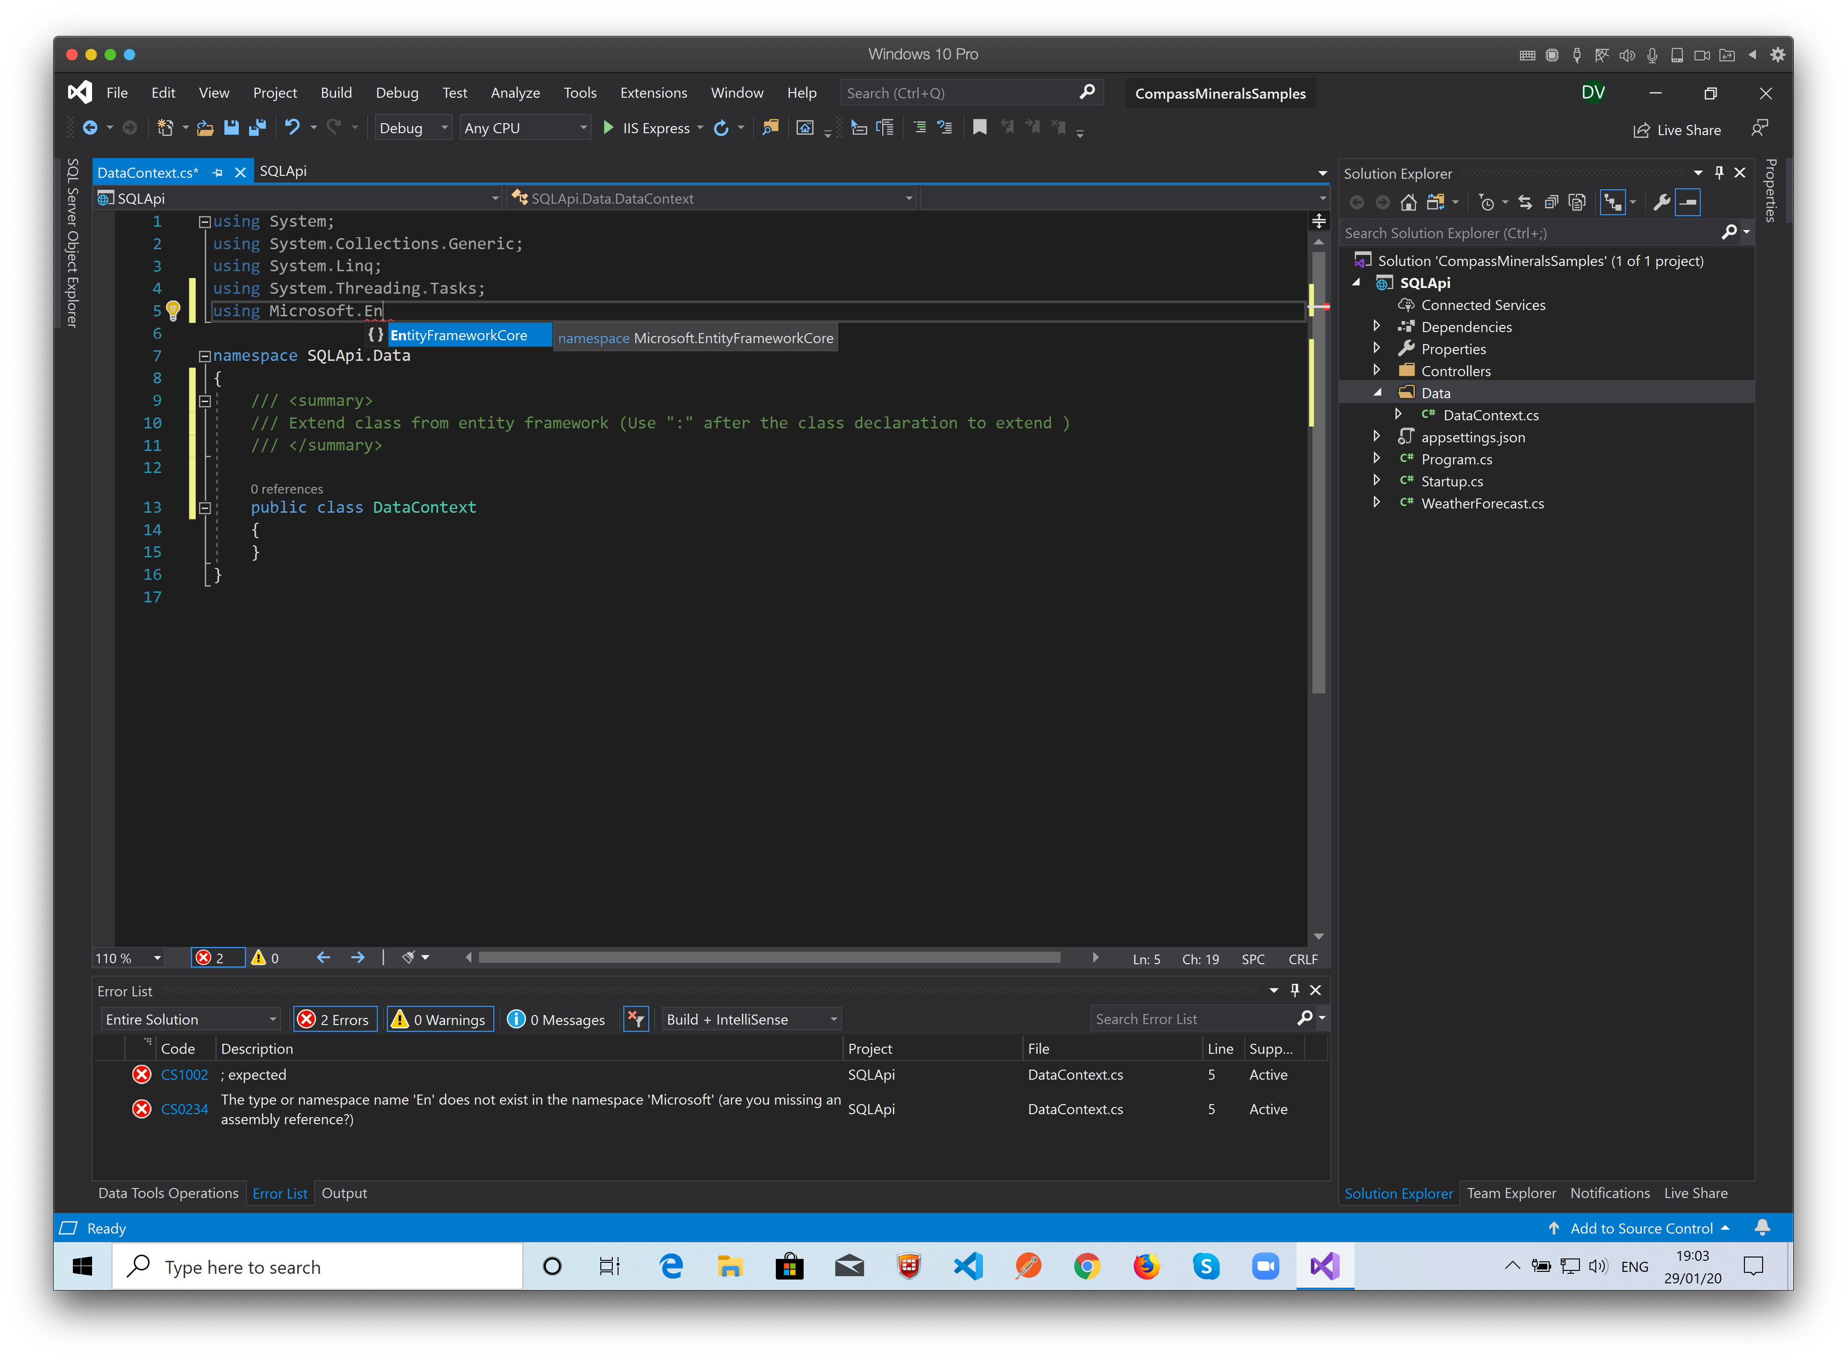
Importing the Entity Framework…

Slide 30
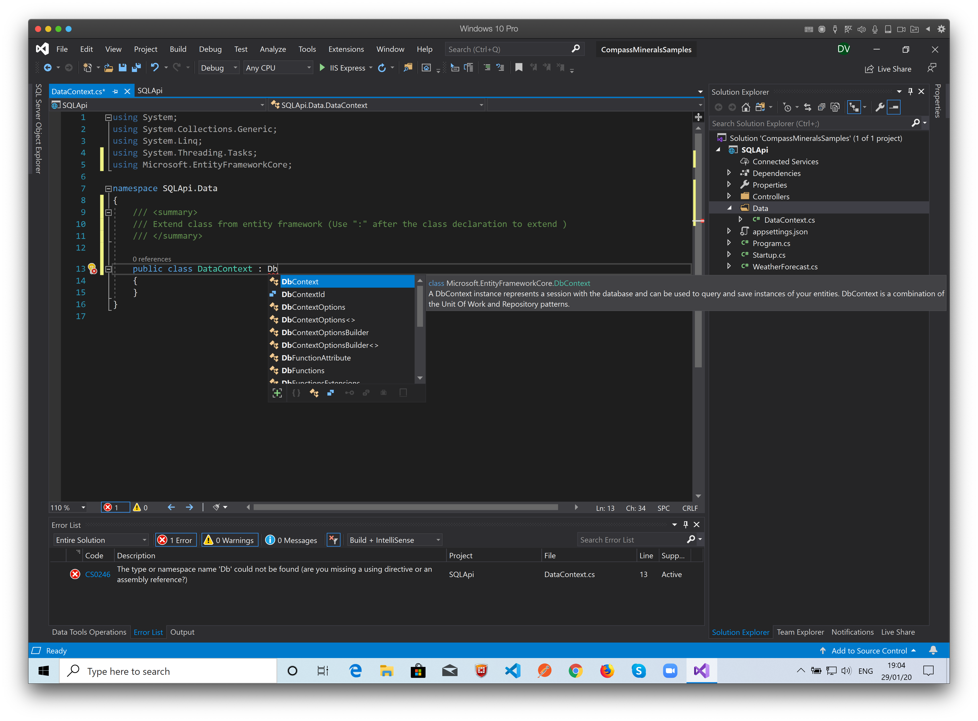
The class must inherit from DbContext Entity framework class…

Slide 31
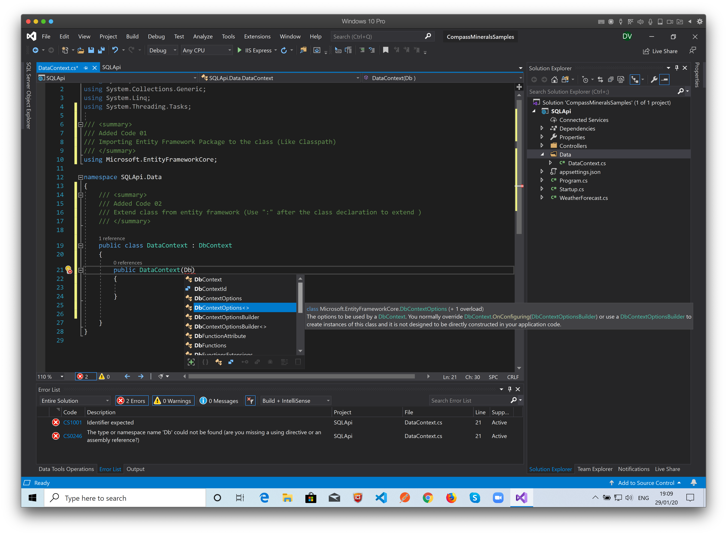
Create the Class Constructor…

Slide 32
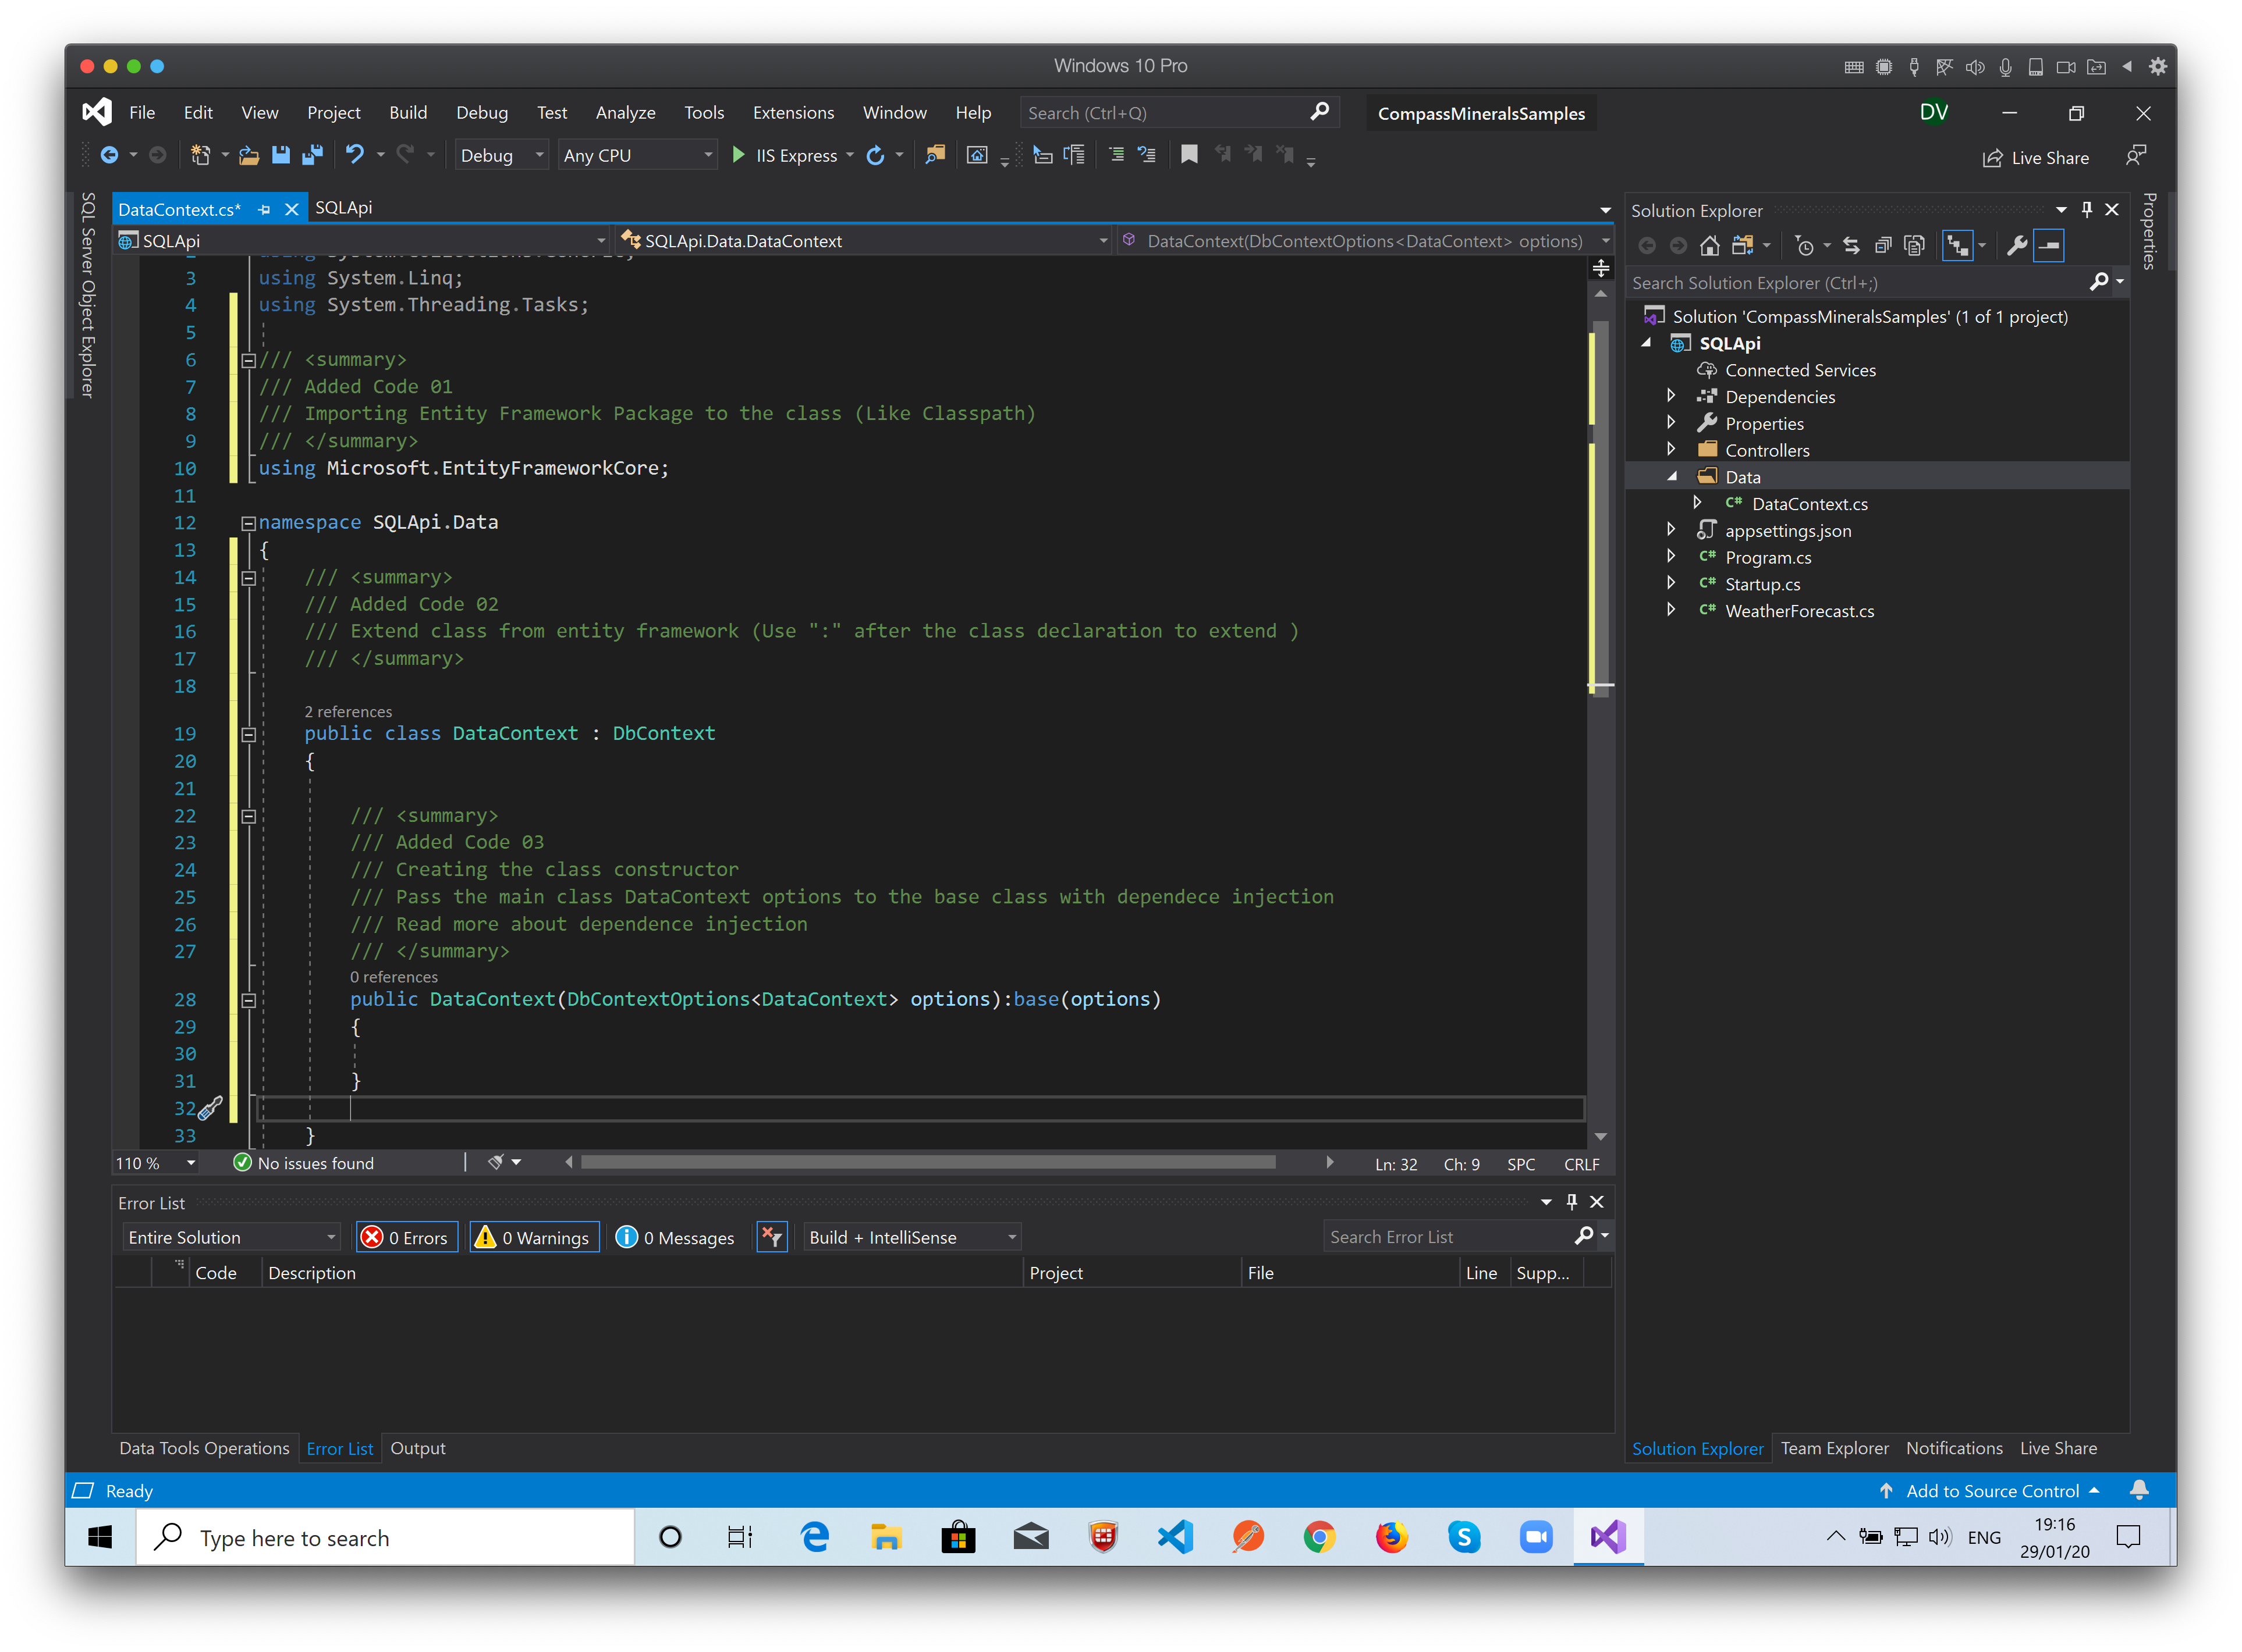
Create the Class Constructor…

Slide 33
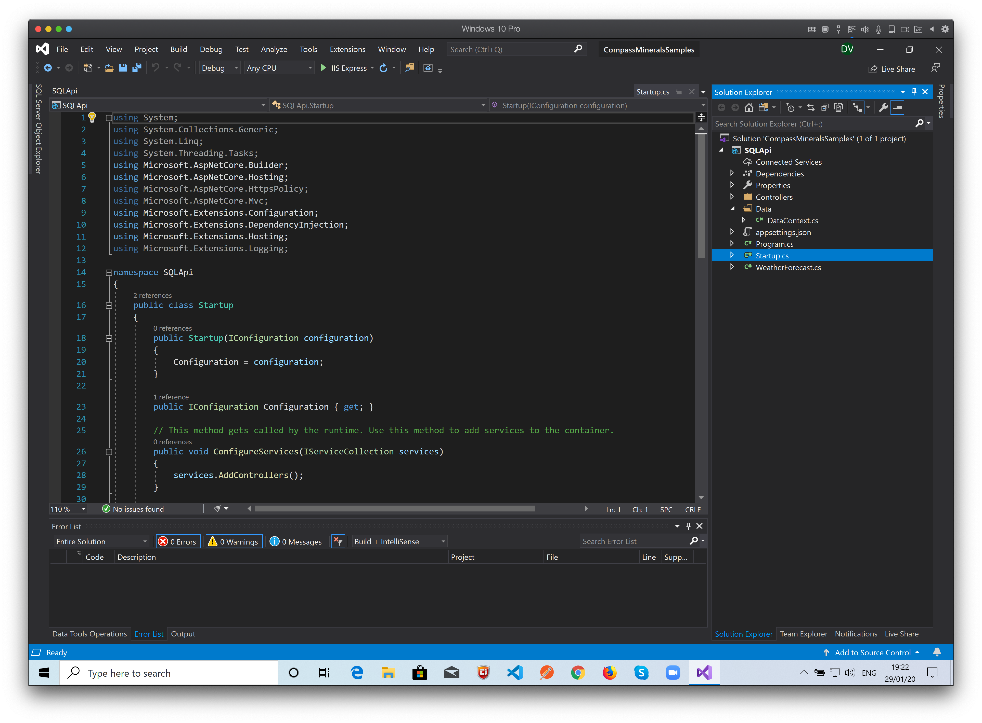
Now configure the DataContext file as a startup service on the Startup.cs class. When the project starts, it will initialize the database objects…

Slide 34
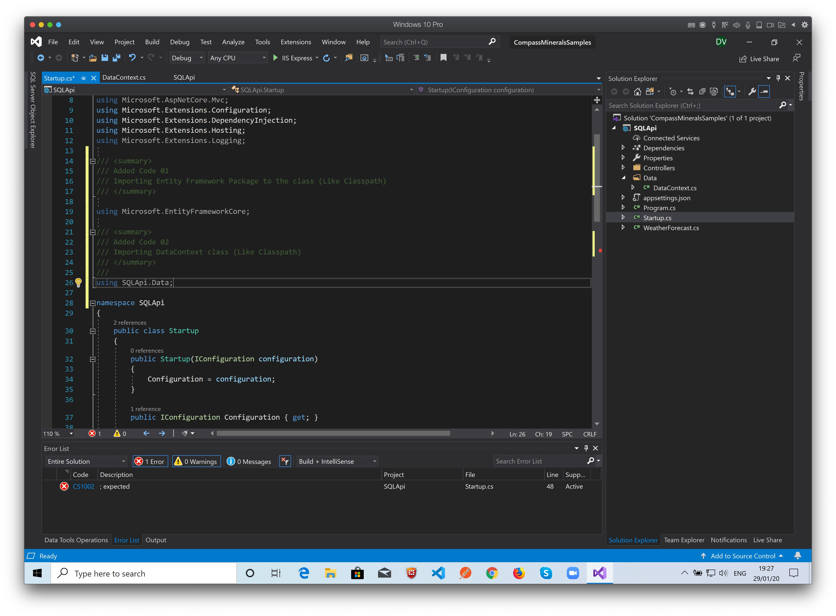
Add Imports…

Slide 35
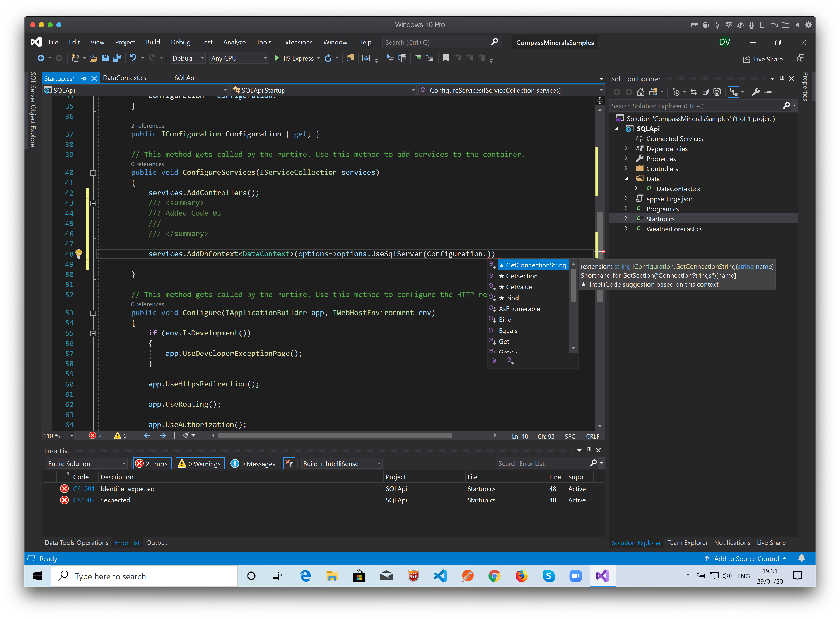
Add the DataContext class as a DbContext service…

Slide 36
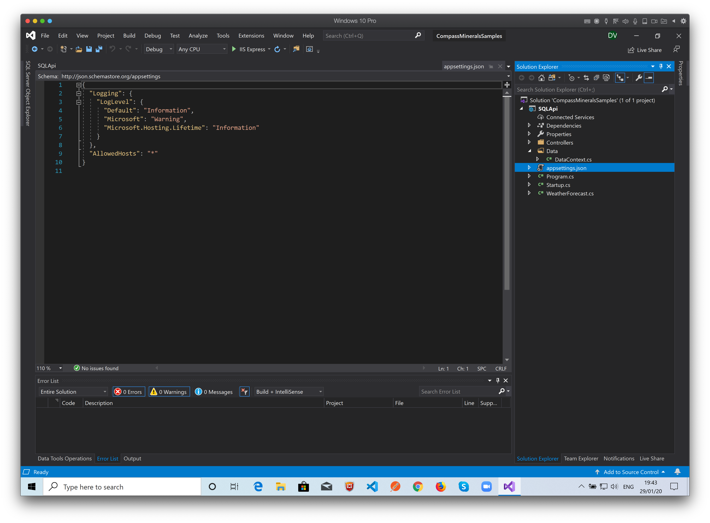
Now, put the connection string to the database on the appsettings.json file…

Slide 37
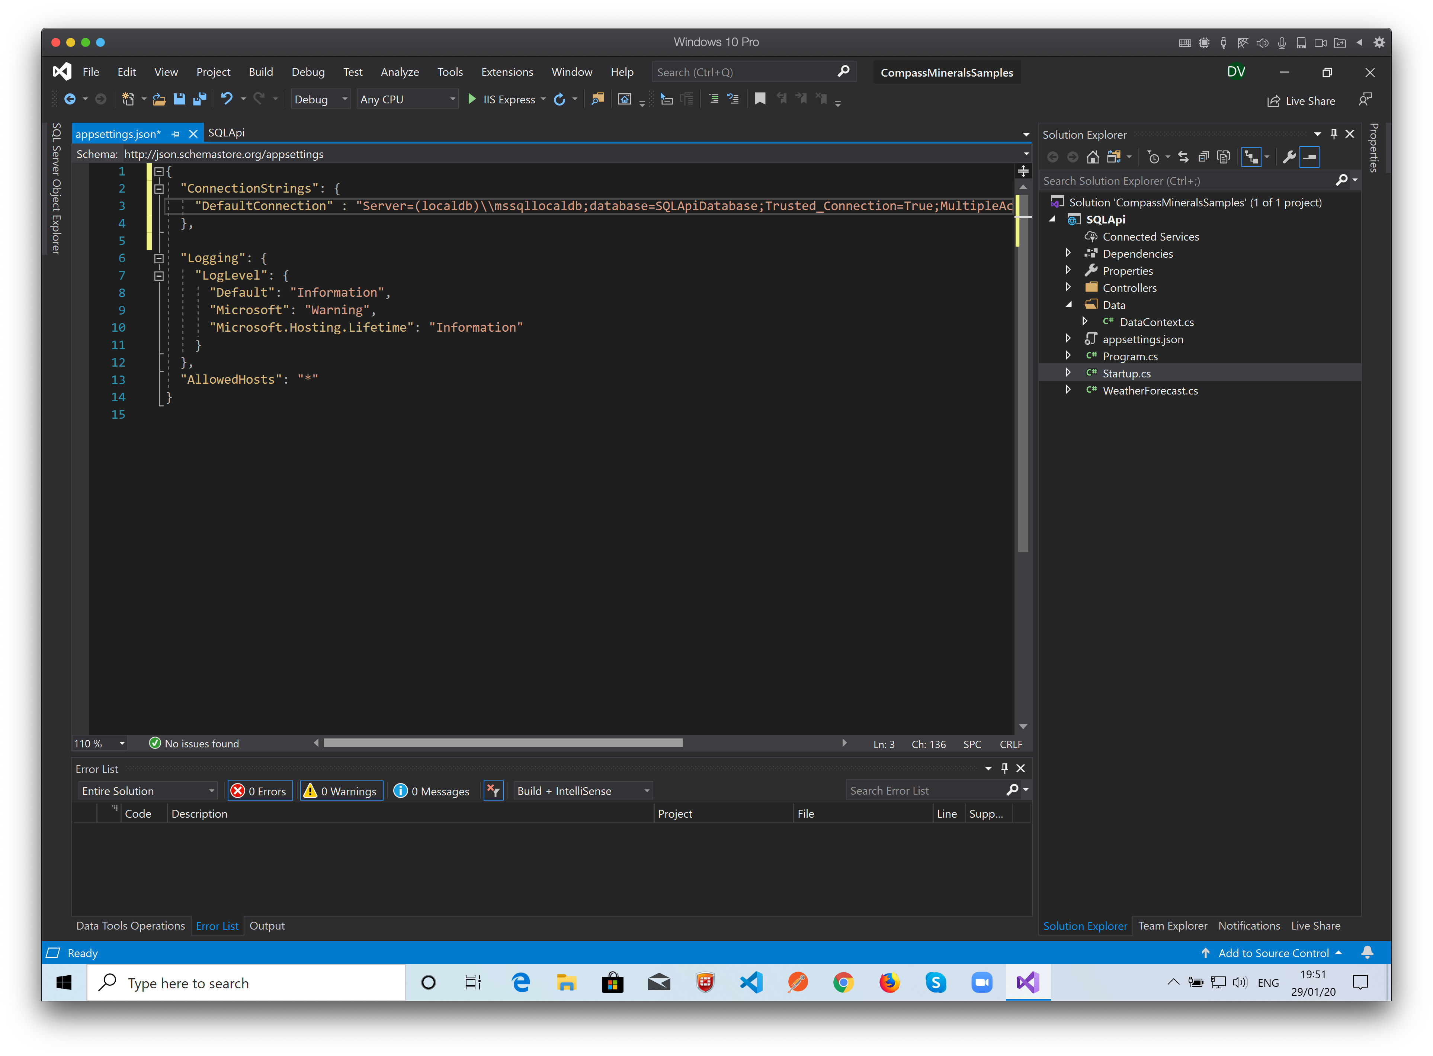
Now, put the connection string to the database on the appsettings.json file…

Slide 38
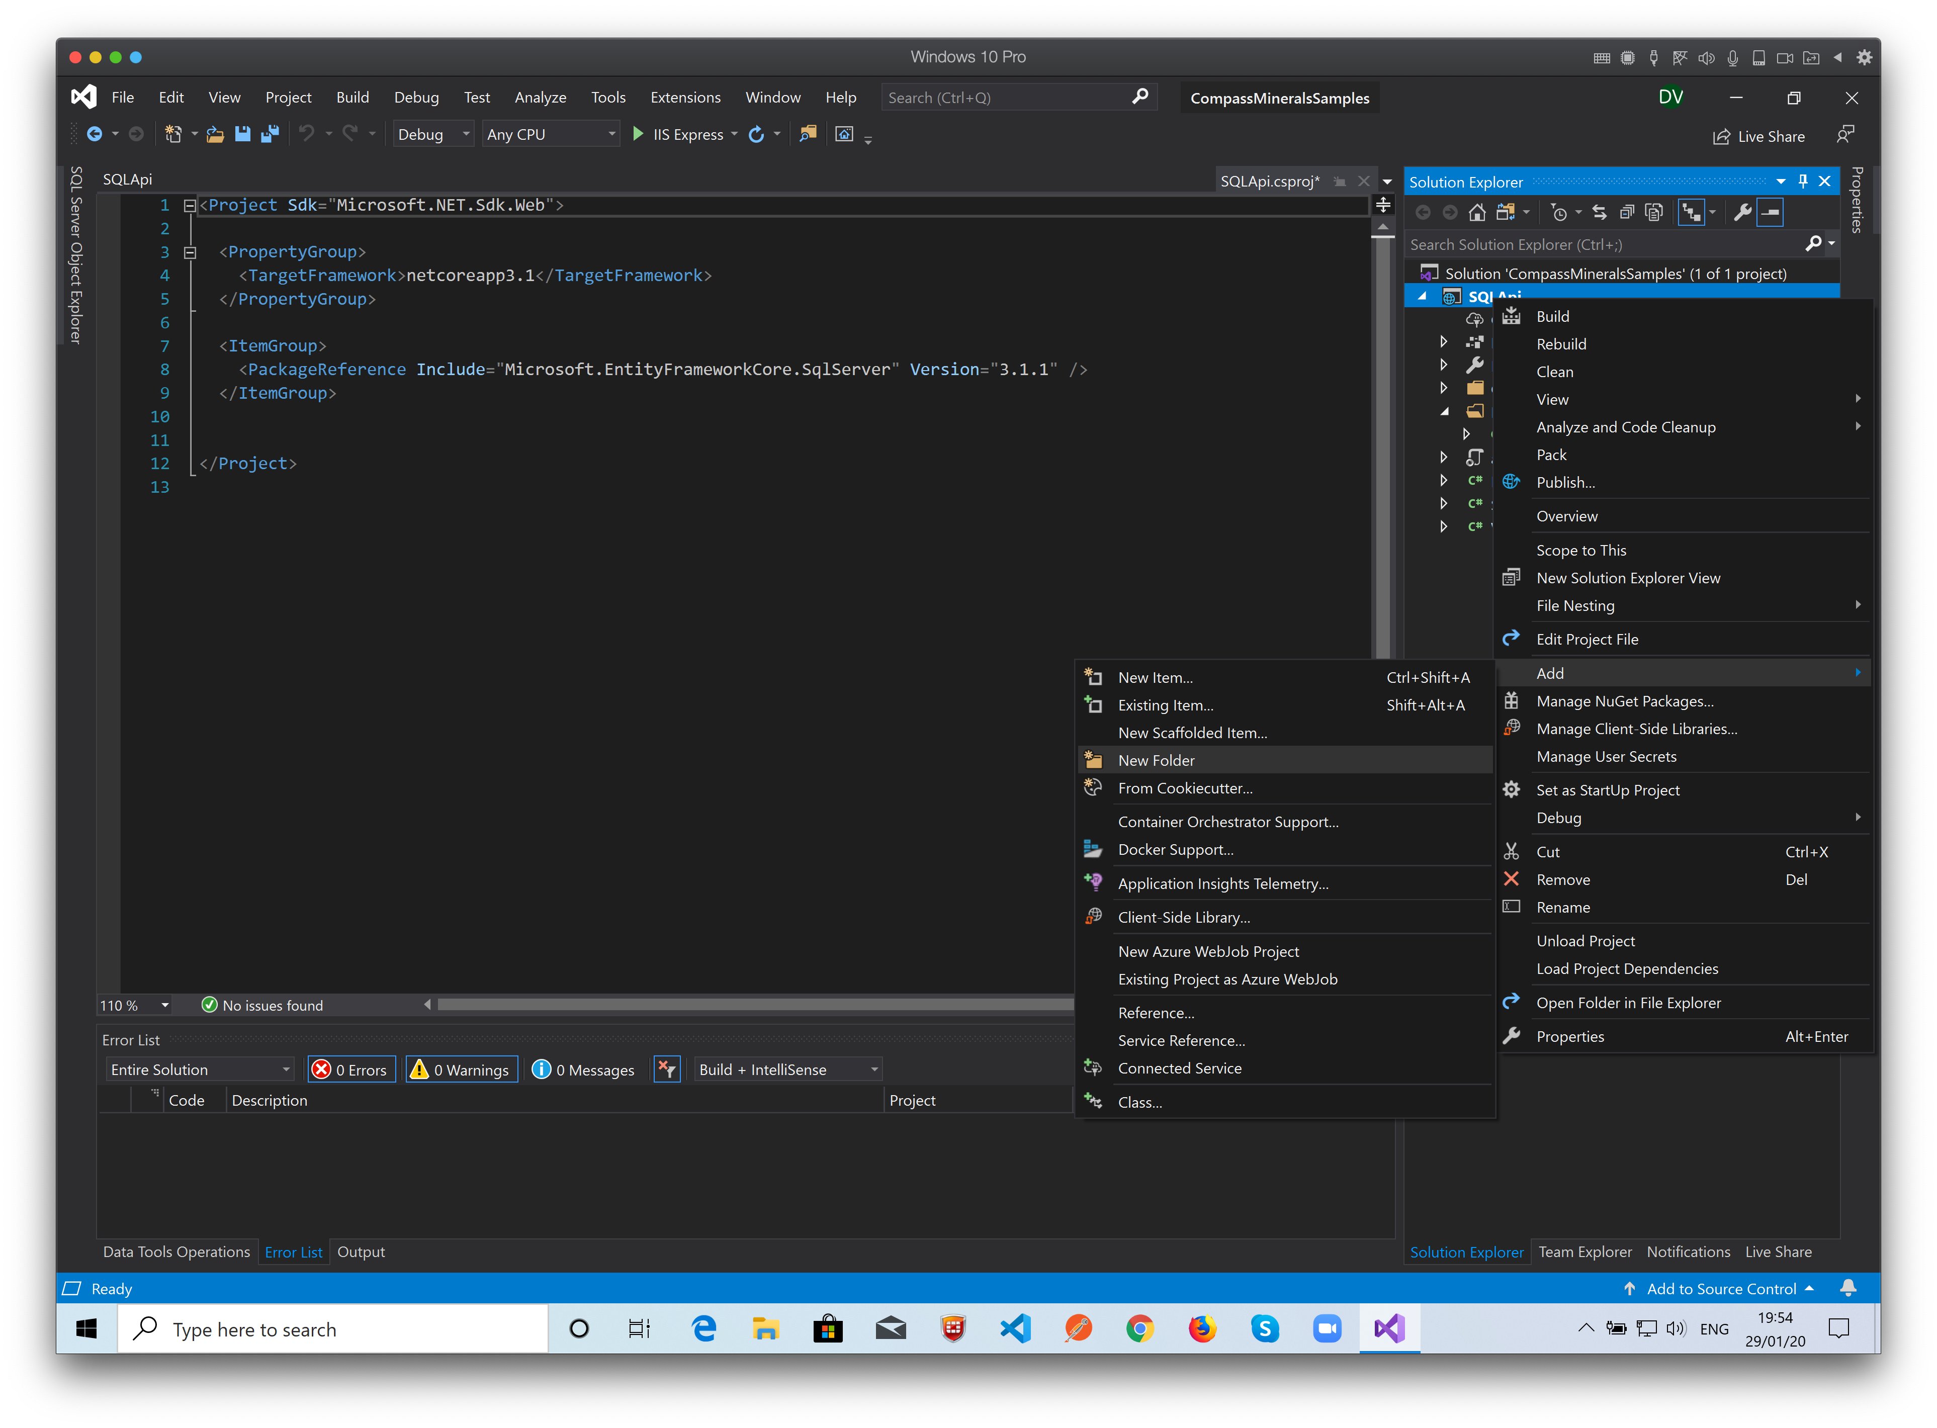
Create the Model
The model represents the records that we get from the database.
We need to add the Models Folder to the project.
Right click the project and select: Add -> New Folder…

Slide 39
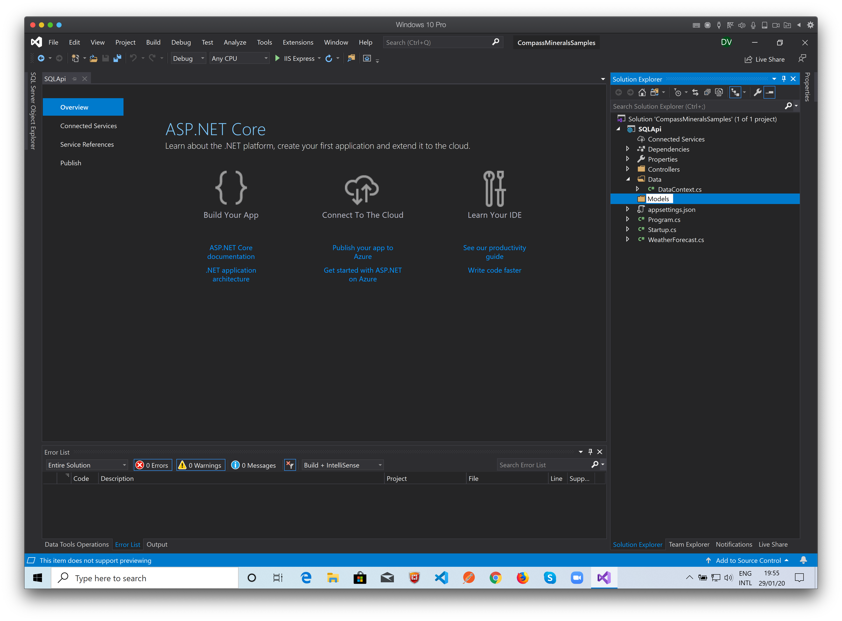
Name it Models.

Slide 40
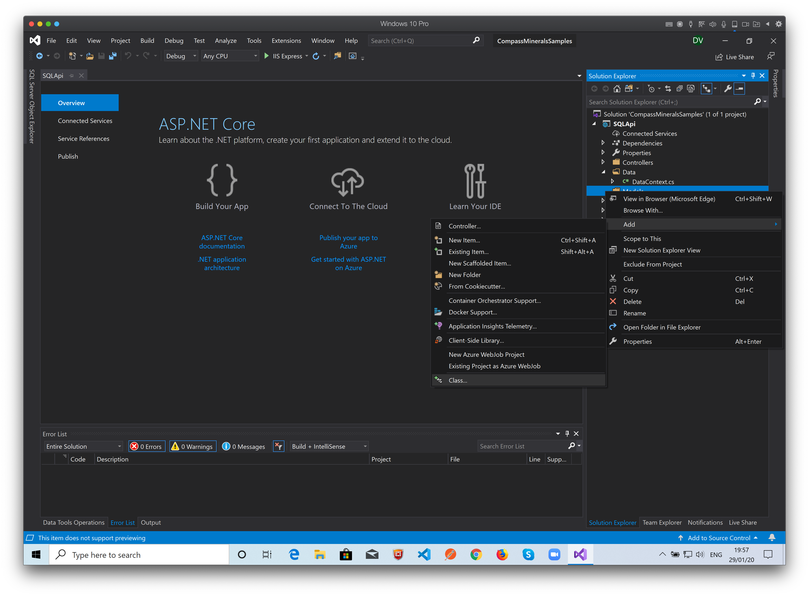
Right click the Models Folder and select: Add -> Class...

Slide 41
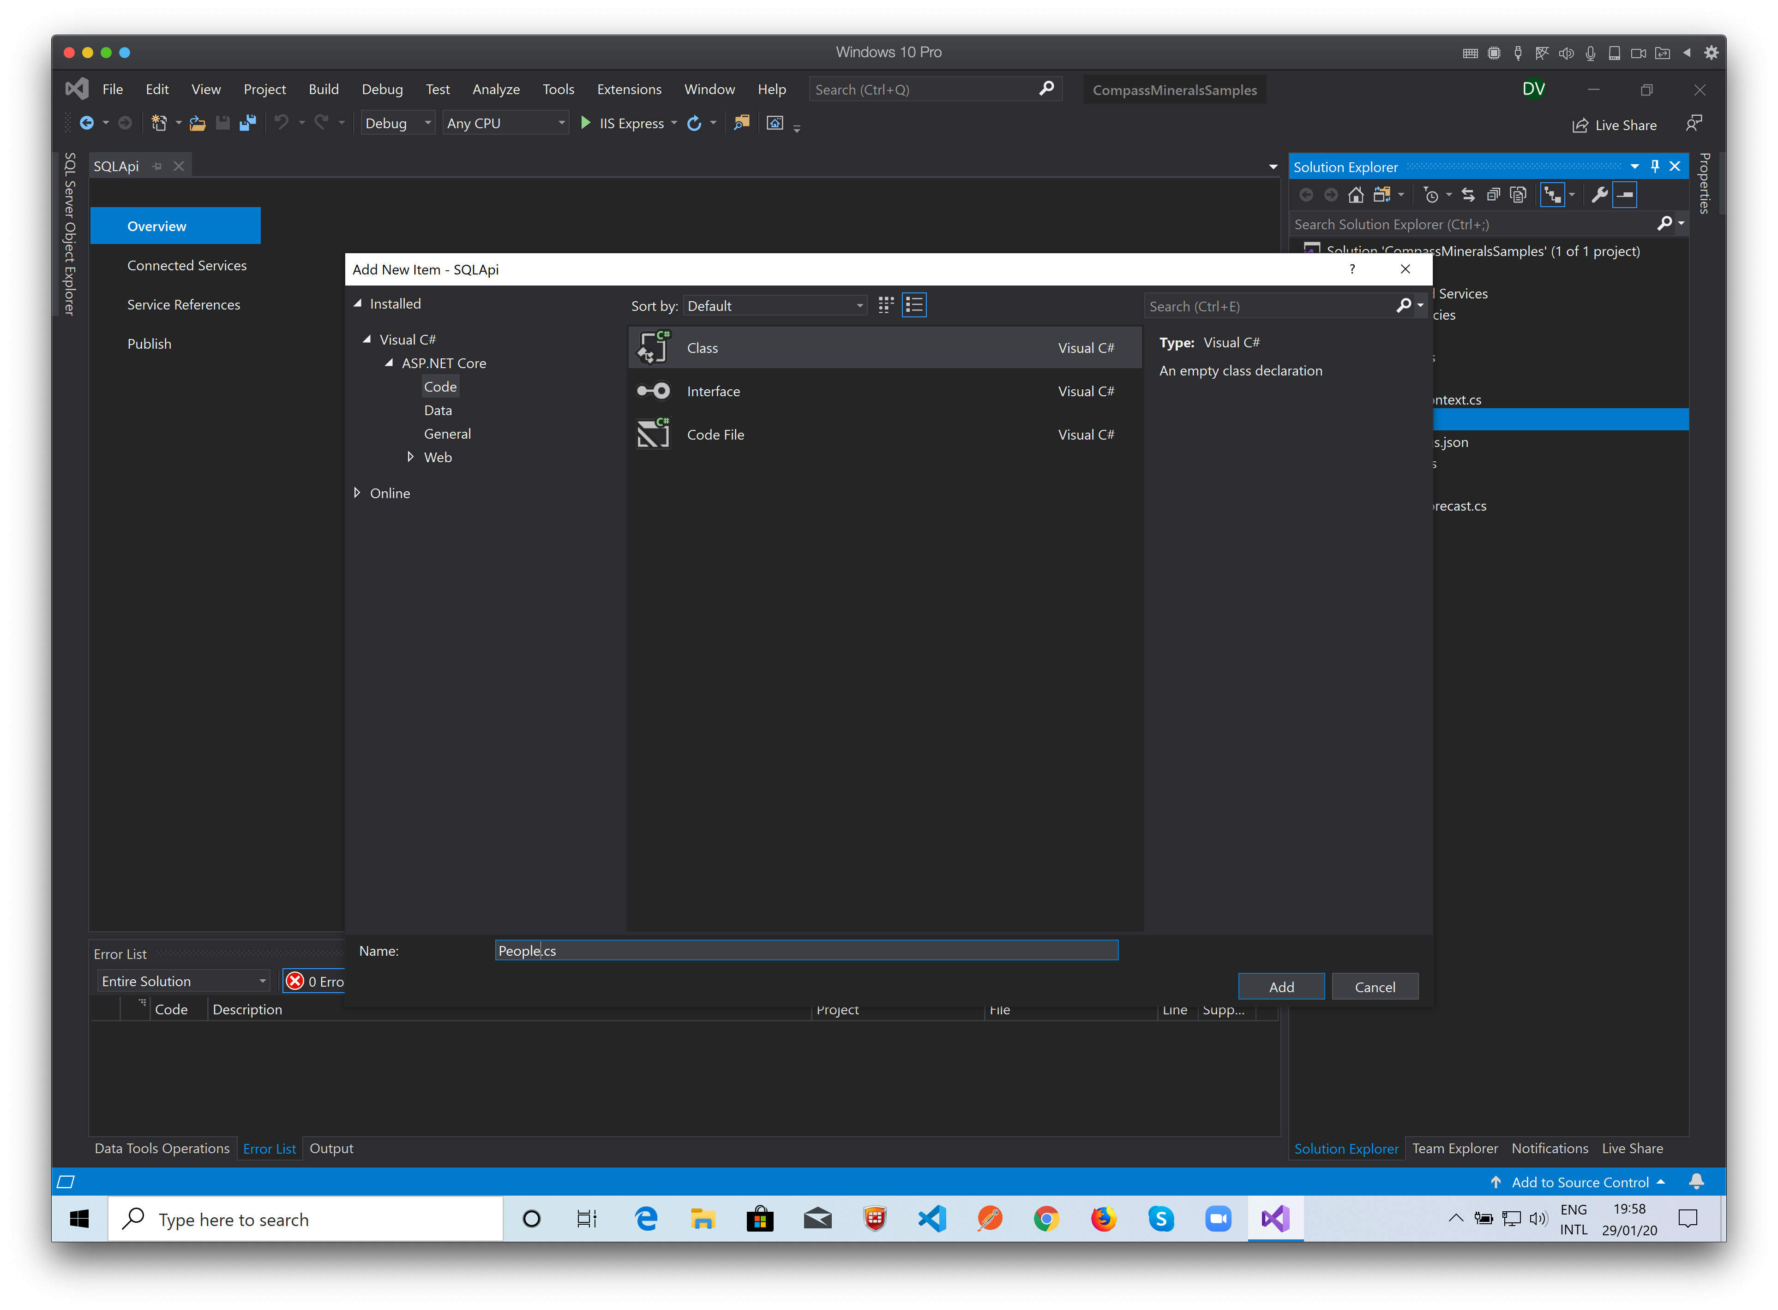
The class name must be the same as the table name…
Click Add…

Slide 42
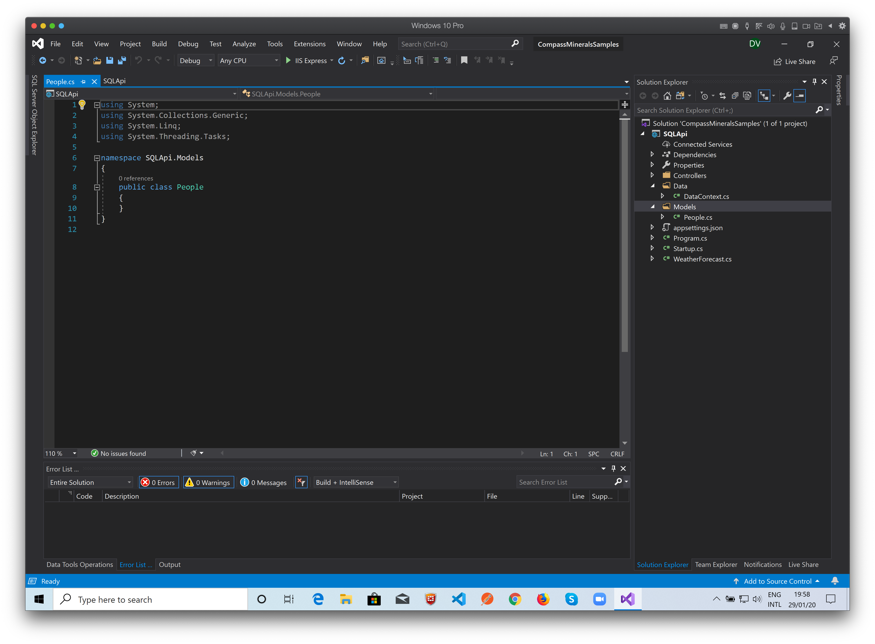
The Model Class file created.

Slide 43
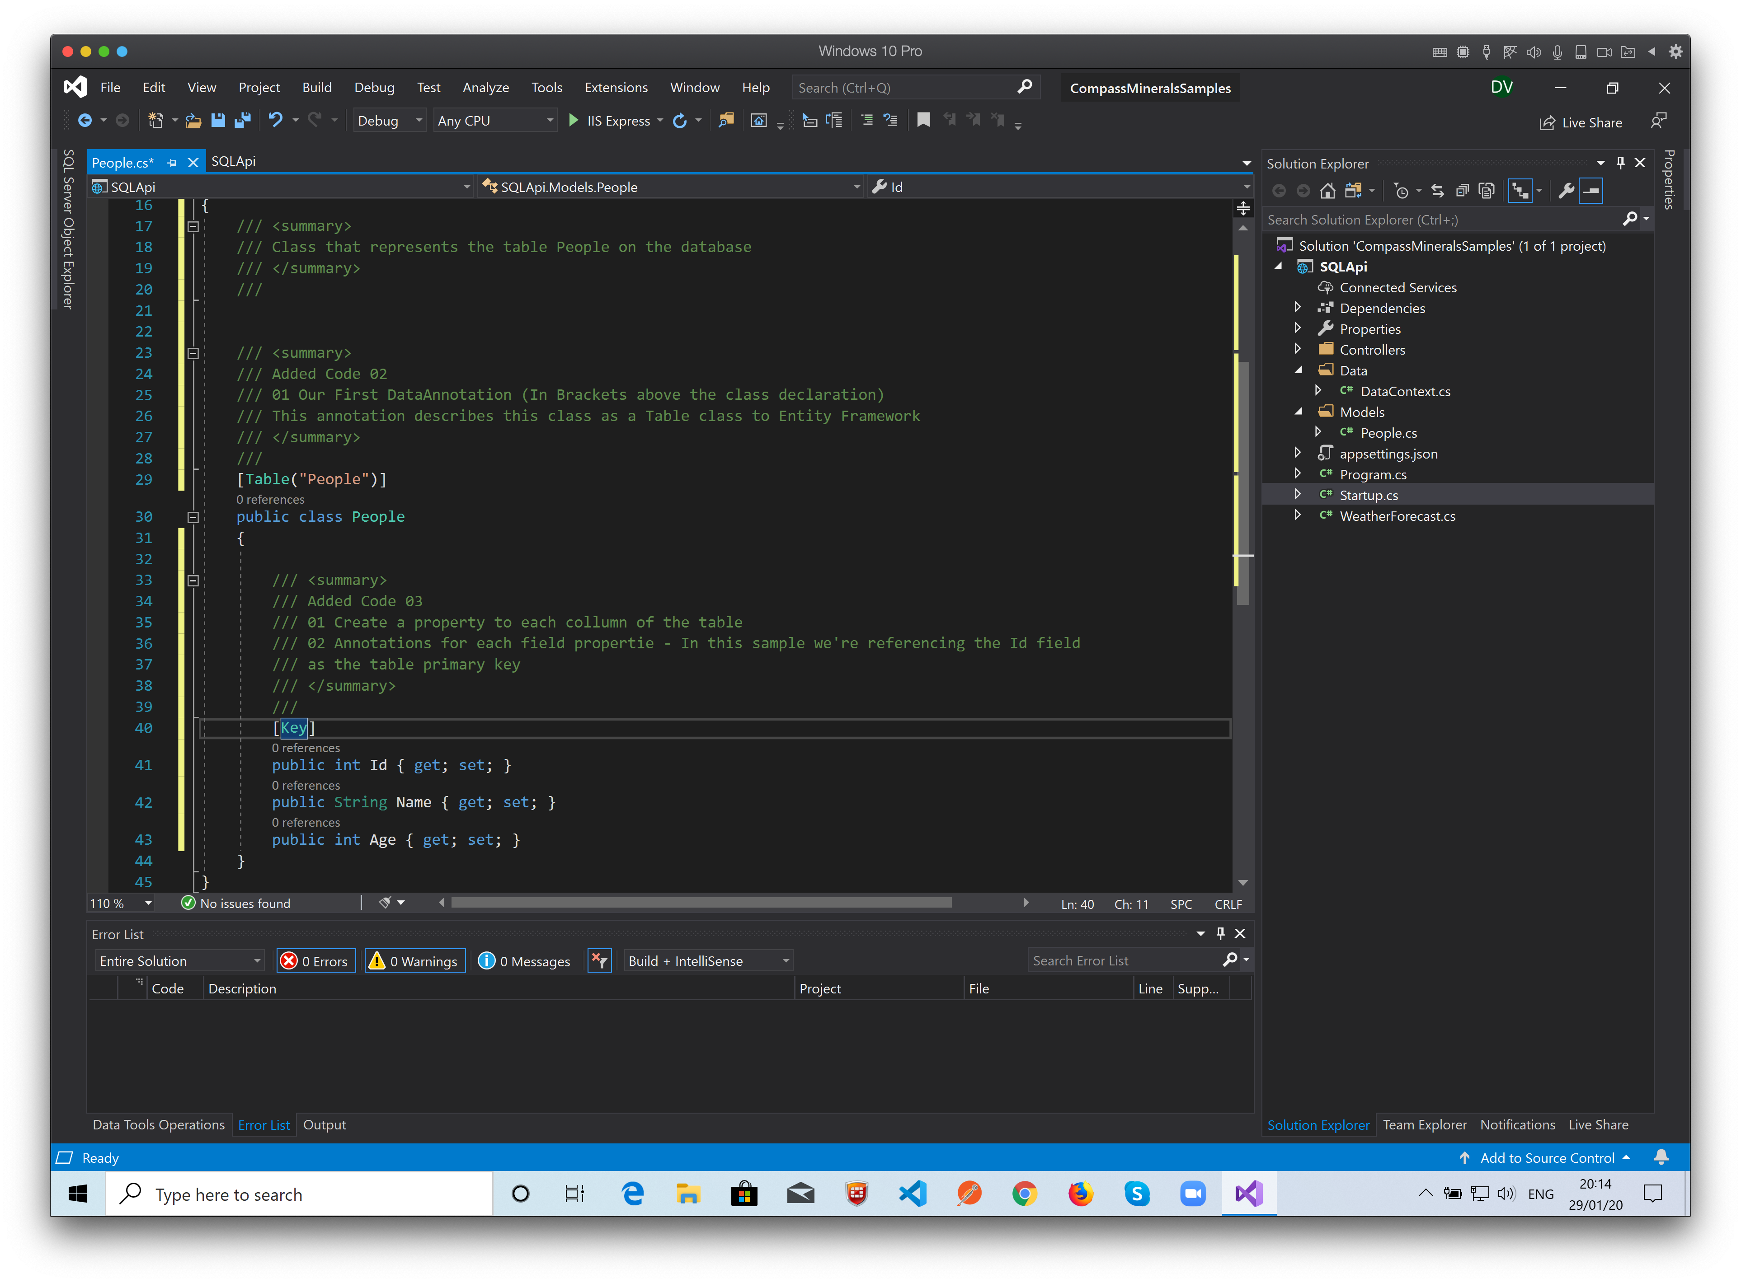
Linking the Class to the table using Entity Framework Data Notations...
The Class represents the table and the properties represents the table’s fields…

Slide 44
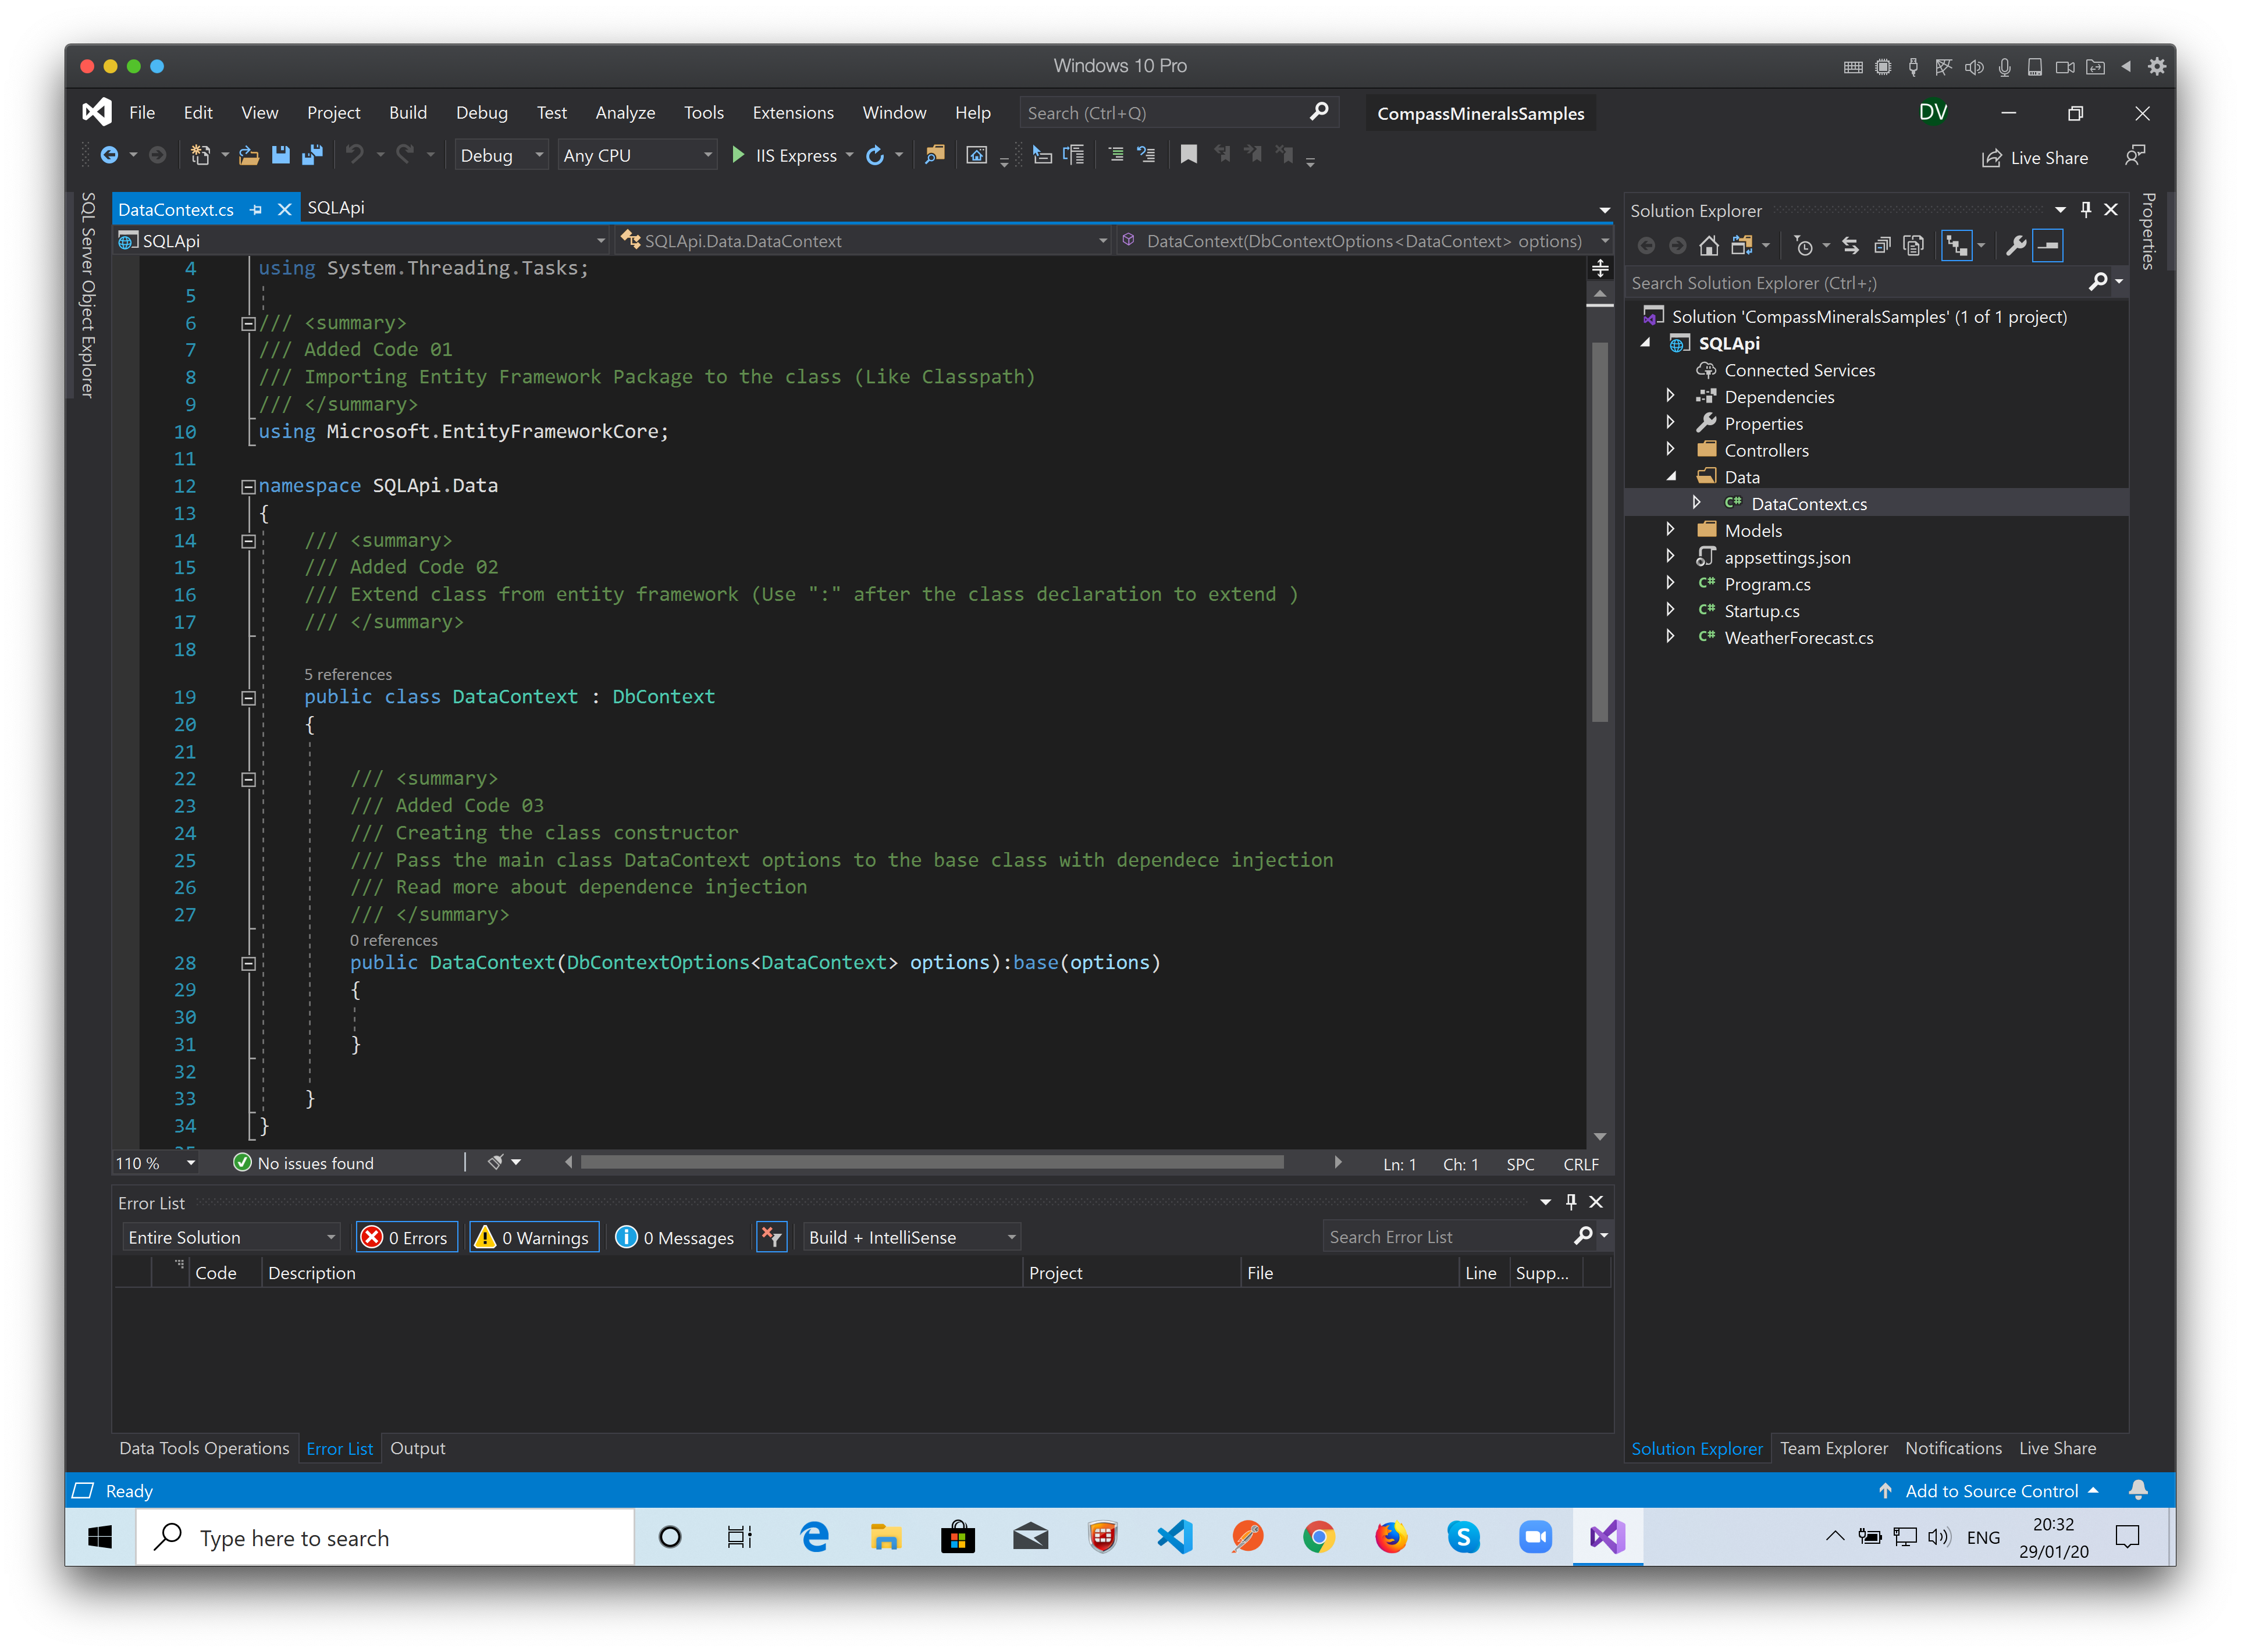
It’s Almost done…
Let’s create the Controller…

Slide 45
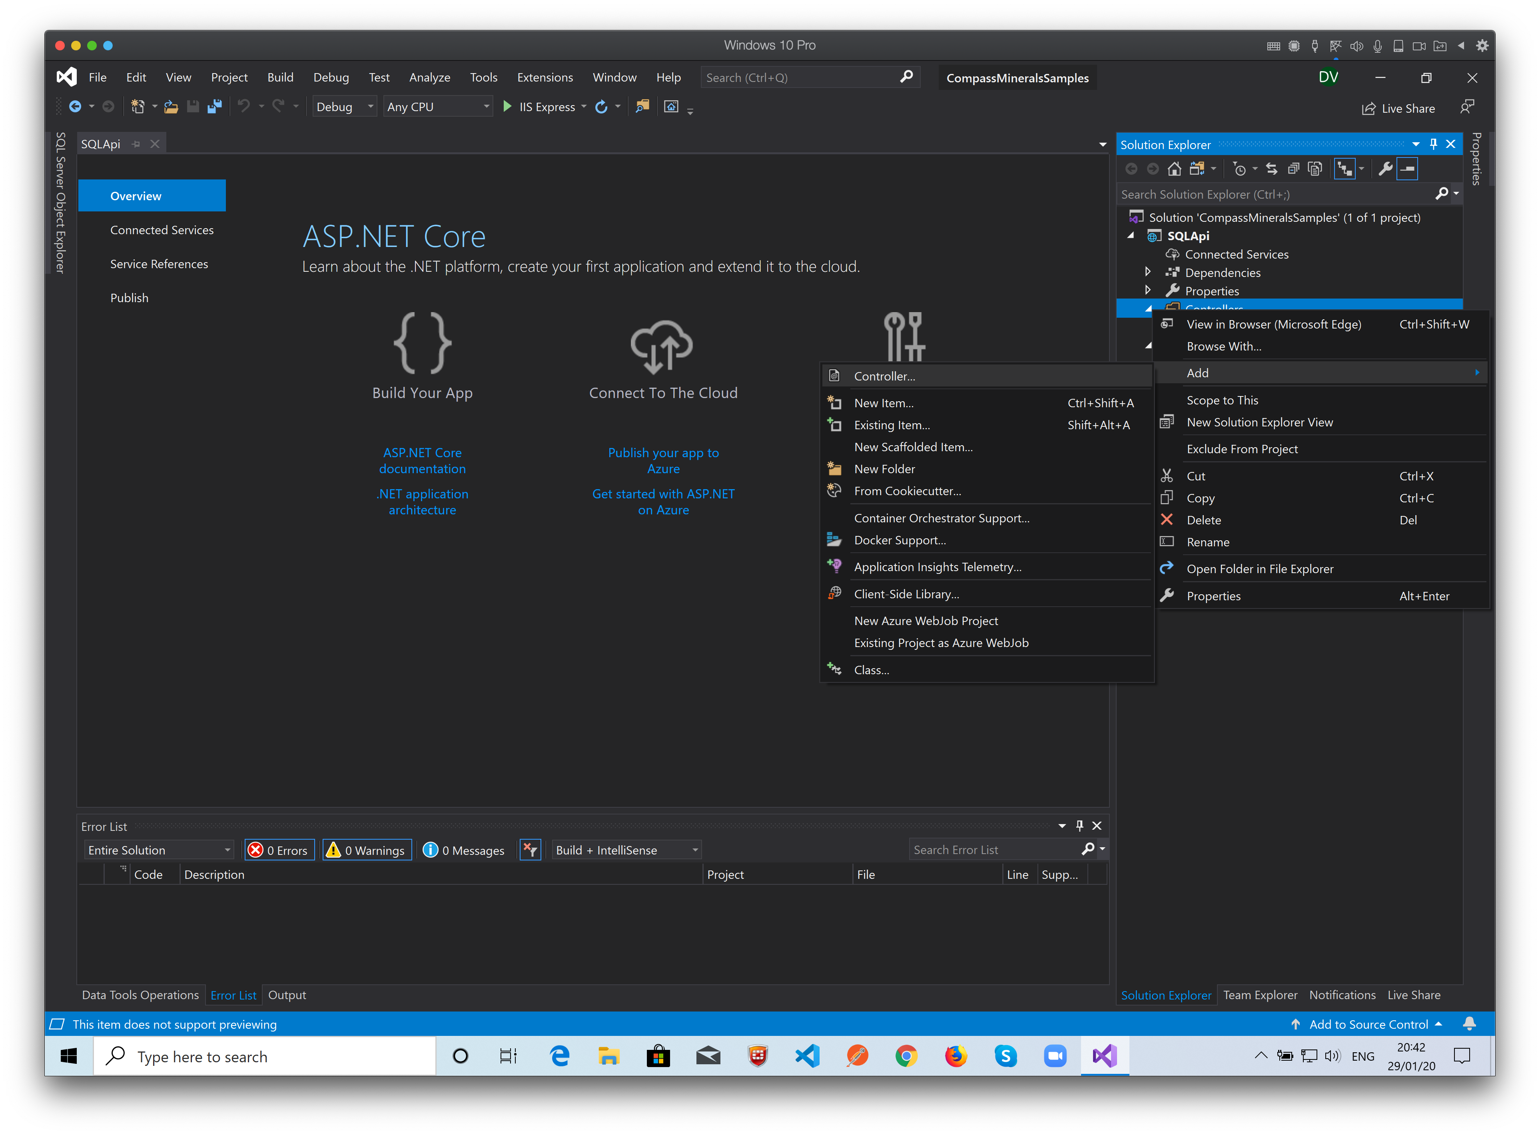
Here is a little different…
Right click the Controllers folder and select: Add -> Controller…

Slide 46
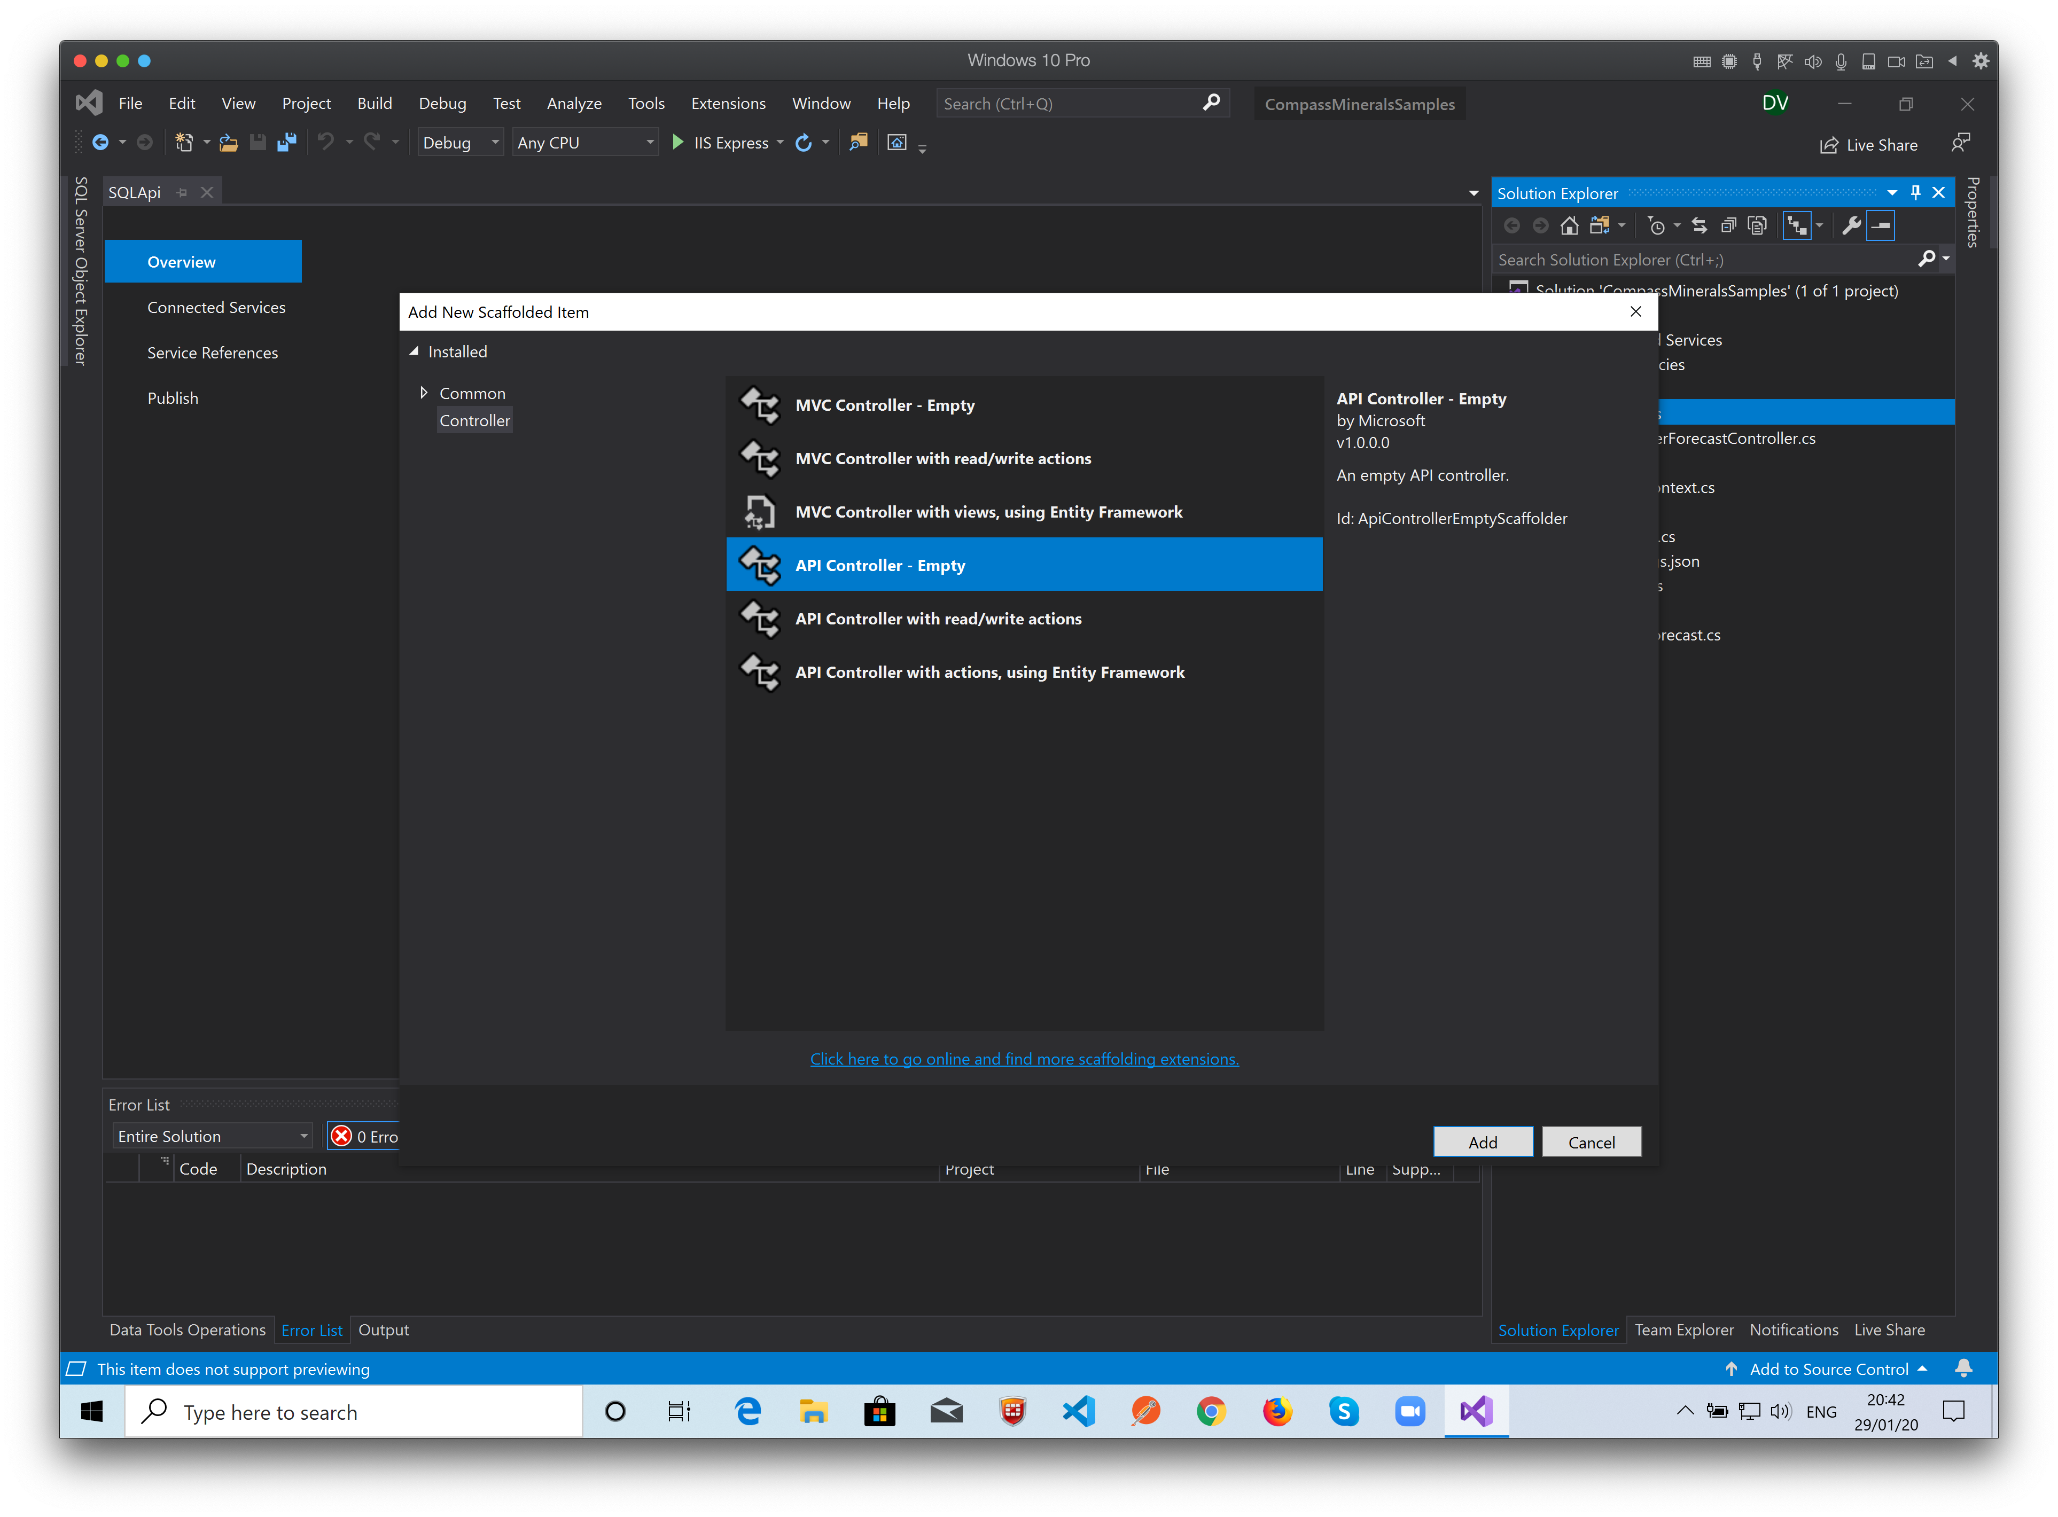
Choose API Controller – Empty and click Add…

Slide 47
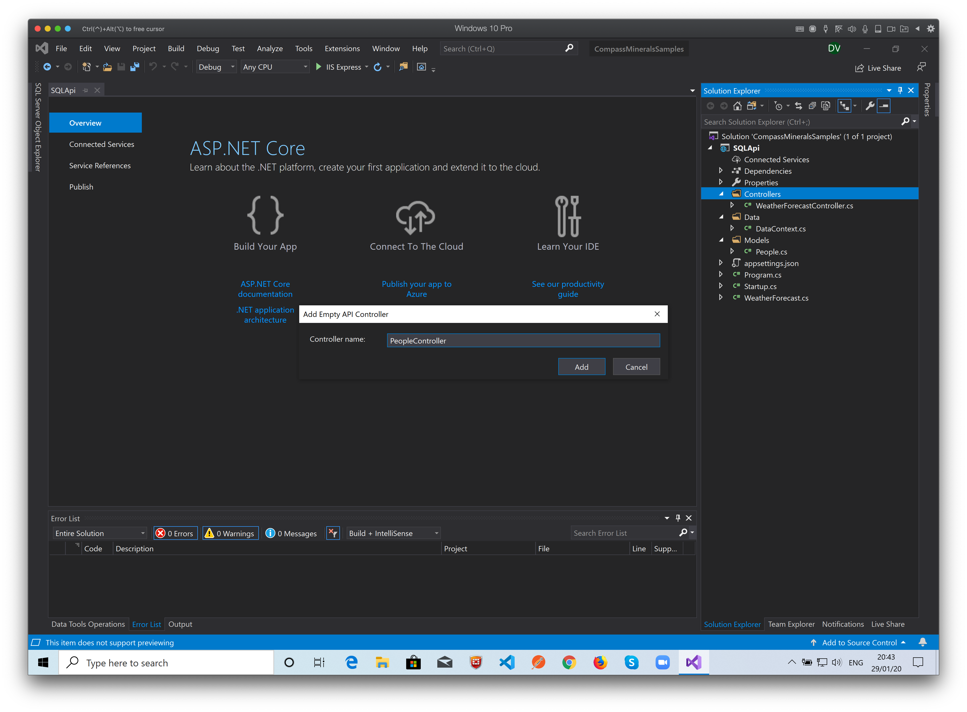
Name it as PeopleController…

Slide 48
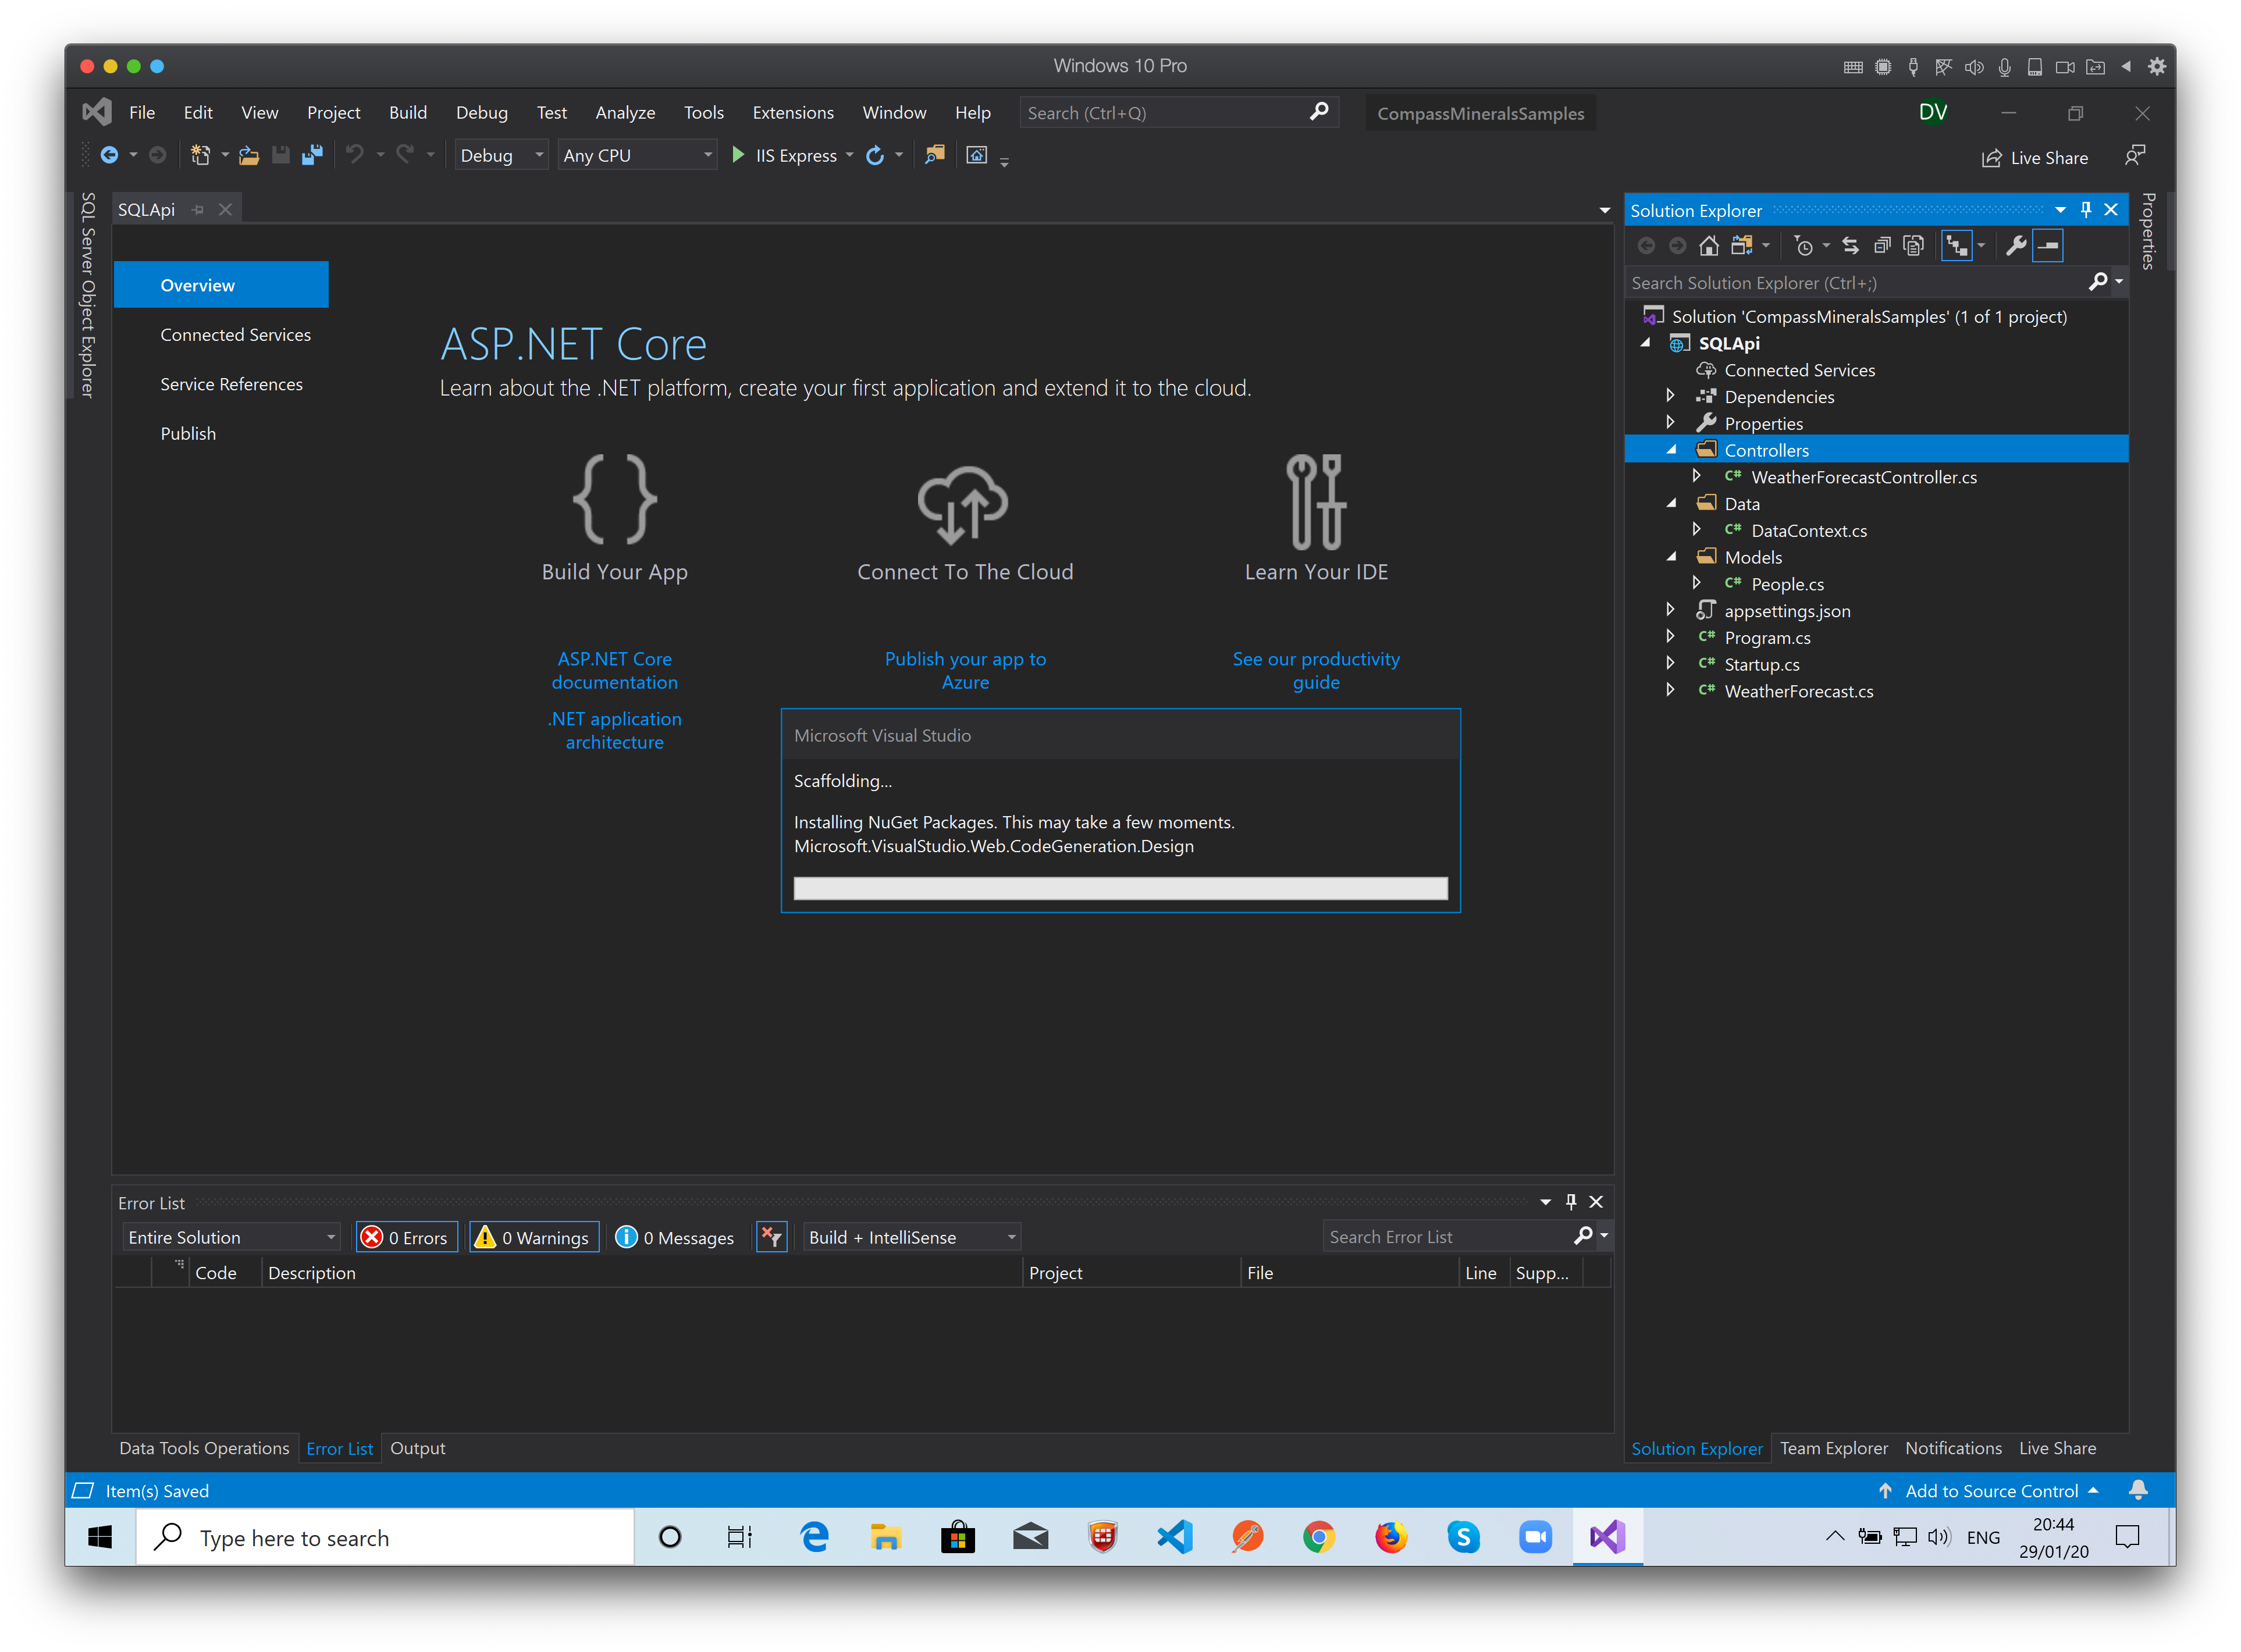
All the dependencies are added to the project automatic by the NuGet Package Manager…

Slide 49
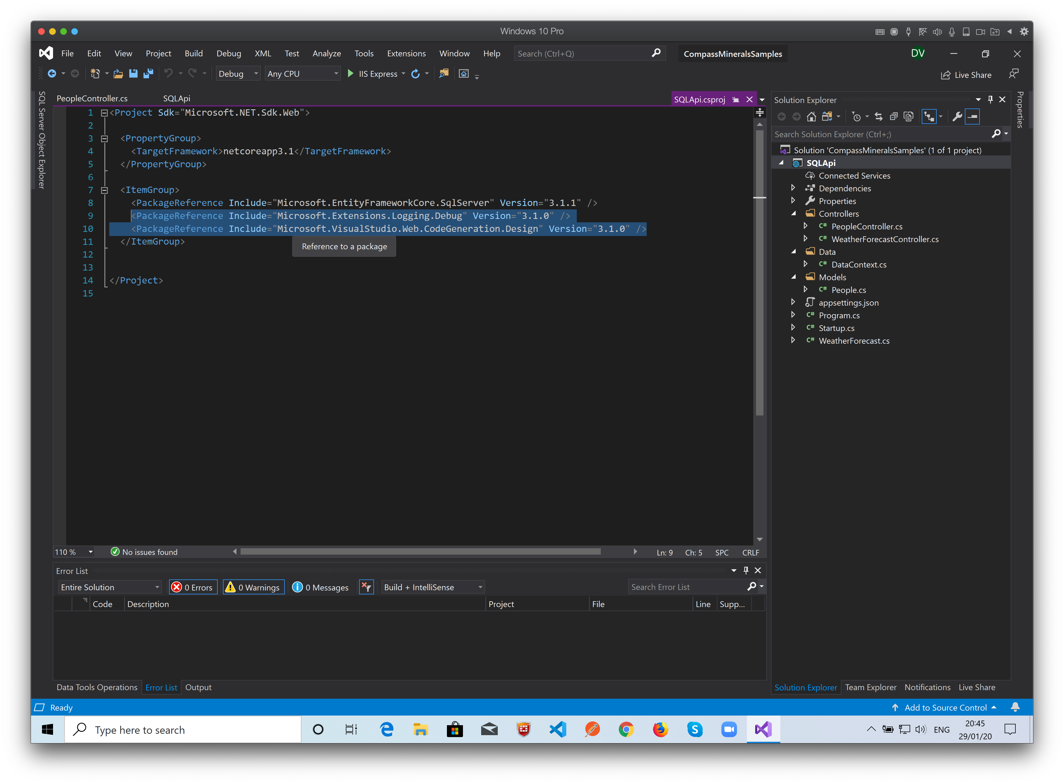
You can see the code added by the NuGet Package to the project…

Slide 50
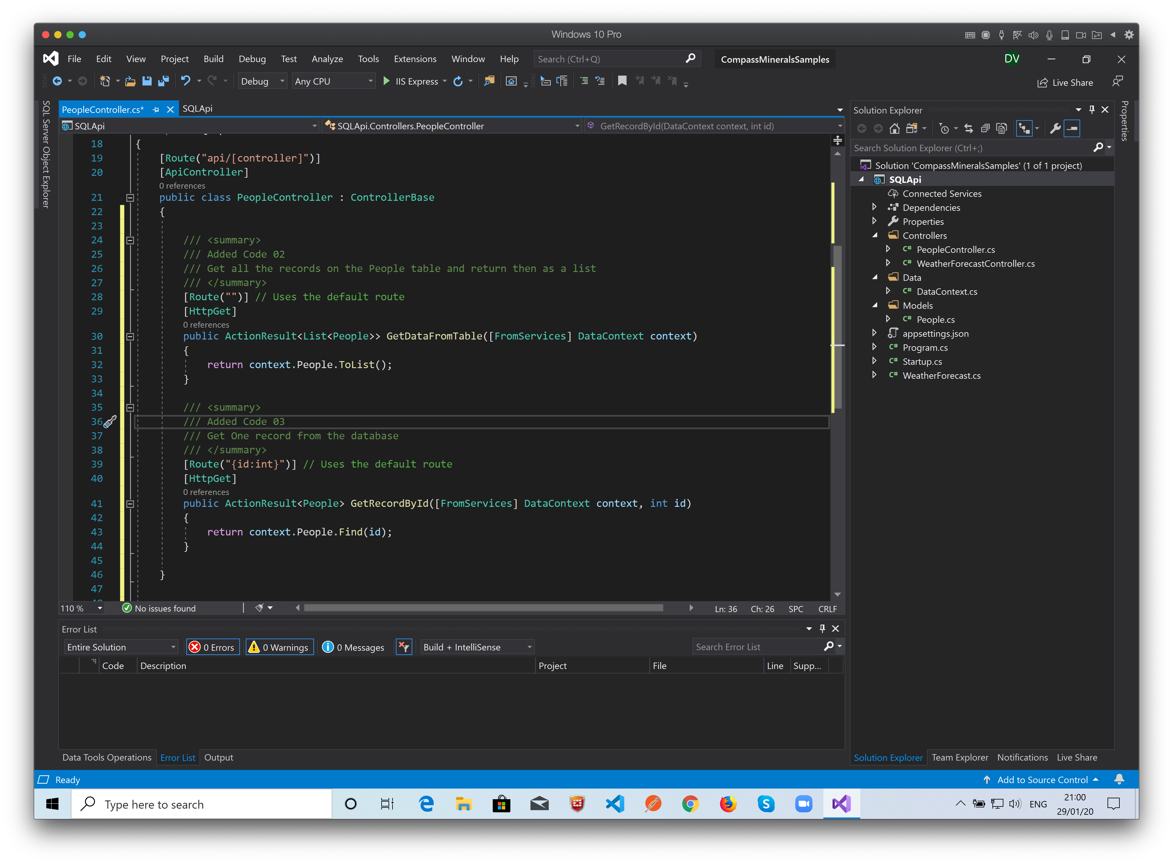
In the controller, we put all the code to manipulate the data…
In the code file we write methods to: Get all records from the table
Get One record by the ID Key
Insert
Update
Delete.
We’re done with our REST Api!!!

